Slide 1
17.4 Sound and Hearing
Sound waves are longitudinal waves that travel through a medium.
Many behaviors of sound can be explained by using a few properties:
Speed
Intensity
Loudness
Frequency
Pitch

Slide 2
Speed
In dry air at 20ºC, the speed of sound is 342 m/s.
More than 10 times faster than your speed in a car on a highway.
Fig 14 on p. 514 in text shows speed of sound in different media.
Travels fastest in solids, slower in liquids, and slowest in gases. Why?

Slide 3
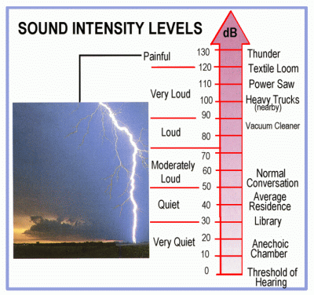
Intensity and loudness
Intensity is the rate at which a wave’s energy flows through a given area.
Intensity depends on amplitude and distance from source.
Measured in decibels (dB) – unit that compares intensities of different sounds. Based on powers of 10.

Slide 4
Intensity and loudness
Loudness is a physical response to the intensity of sound, modified by physical factors.
Depends on intensity, health of ears, and how your brain interprets the information in sound waves.

Slide 5
Frequency and Pitch
Frequency depends on how fast the source is vibrating. The faster the vibration, the higher the frequency.
Pitch is the frequency of a sound as you perceive it.
Pitch depends on frequency, but it also depends on other factors (like age or health of ears).

Slide 6
Ultrasound
Used in a variety of applications like sonar and ultrasound imaging.
Sonar is a technique using wave reflection to determine an object’s distance under water.
Stands for sound navigation and ranging.
Distance calculated using the speed of sound under water and the time that the sound wave takes to reach the object and the echo to return.

Slide 7
The doppler effect
A change in sound frequency caused by motion of the source, listener, or both.
As source of sound approaches, observer hears a higher frequency. As it moves away, a lower frequency.

Slide 8
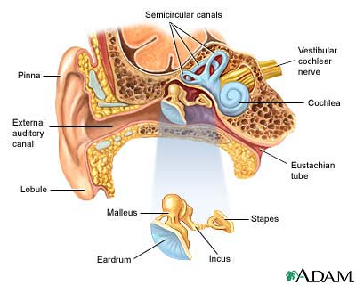
Hearing and the Ear
Outer ear – gathers and focuses the sound.
Middle ear – receives and amplifies the vibrations.
Inner ear – uses nerve endings to sense vibrations and send signals to the brain.

Slide 9
How do we Reproduce sound?
Recorded by converting sound waves into electronic signals. (Like in our ears)
Reproduced by converting electrical signals back into sound waves.

