Slide 1
HAP Chapter 1
“Intro to HAP”
-Introduction
-Hap definition
-levels of organization
-characteristics of life
-maintenance of life
-Body Organization
-Anatomical terminology

Slide 2
I. Intro the HAP
A. History
1. Began with earliest ancestors
a. Concerned with injury and illness
-superstitious, potions, magic, herbs
b. Observations led to treatment
2. Modern Medicine
a. Based on these practices
b. Became more accurate and precise
c. Based on greek and latin terms

Slide 3
II. HAP Defined
A. Anatomy
1. Def – science that deals with the structure of body parts and how they are organized.
2. Well organized
B. Physiology
1. Def – science that deals with the function of the human body and its parts.
C. Why study HAP together? (pg. 2)

Slide 4
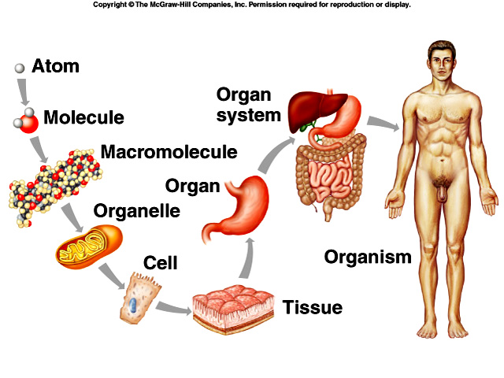
III. Levels of Organization

Slide 5
IV. Characteristics of Life
A. Metabolism
1. The total sum of chemical reactions in body.
→Food and drink = fuel
→“internal engine”
2. Energy leads to life… (pg. 5)
Movement | Responsiveness | Growth | Absorption | Respiration
Digestion | Reproduction | Circulation | Assimilation | Excretion

Slide 6
V. Maintenance of Life
A. Requirements of Organisms
1. Water
2. Foods
3. Oxygen
4. Heat
5. Pressure
*Which of the previous are “vital signs” a nurse or doctor would check?
B. Homeostasis
1. Def – having a stable internal environment

Slide 7
  2. Homeostatic Mechanisms
  a. Receptors
  →provide info about specific conditions in the internal environment
  b. Set Point
  →A value the body should have or maintain
  c. Effectors
  →cause a response to alter conditions
  d. Negative feedback
  →the gradual shutdown of effectors
  e. Ex: pg. 6

Slide 8
VI. Organization of the Human Body
A. Body Cavities (pg. 9)
1. Axial – head, neck, and trunk
a. Cranial
-skull, spinal cord
b. Vertebral Canal
c. Thoracic
-lungs, ribs, and muscles
d. Abdominopelvic
-stomach, liver, spleen, hip bones, intestine, bladder, reproductive organs
e. Other cavities…
-oral, nasal, orbital, middle ear
2. Appendicular – upper and lower limbs

Slide 9
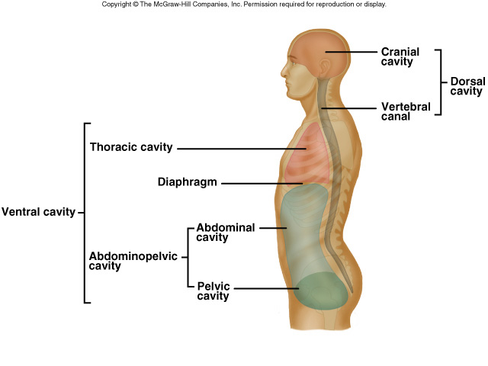

Slide 10
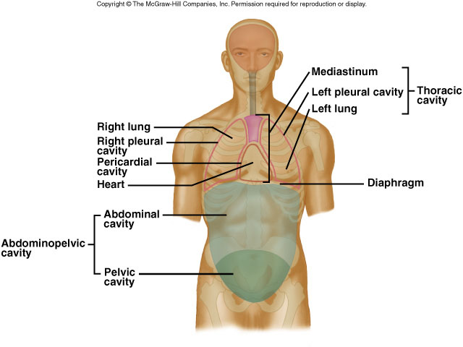
3. Other Cavities
a. Pleural
- lungs
b. Pericardial
- heart

Slide 11
4. Terms
a. Mediastinum – region that separates the thoracic cavity into right and left halves.
b. Viscera – cavity that contains organs.
c. Diaphragm – thin muscular wall that separates the abdominal cavity from the thoracic cavity.
d. Membrane – thin coating that covers an organ.

Slide 12
B. Organ Systems
1. Integumentary – skin
2. Skeletal – bones, ligament, tendons
3. Muscular – muscles
4. Nervous – brain, spinal cord
5. Endocrine – glands and hormones
6. Cardiovascular – heart, veins, arteries, blood
7. Lymphatic – spleen, lymph nodes and fluid
8. Digestive – breakdown of foods and fluid
9. Respiratory – lungs, air exchange
10. Urinary – kidneys, bladder
11. Reproductive – male and female

Slide 13
VII. Anatomical Terminology
A. Relative Position
1. superior / inferior
2. anterior / posterior
3. medial / lateral
4. proximal / distal
5. superficial / deep
B. Body Sections
1. Sagittal – right and left halves
2. Transverse – top and bottom halves
3. Coronal – front and back halves

Slide 14
