Slide 1
Physical Science
Chapter 15 Energy

Slide 2
15.1 Energy and its Forms
Energy – the ability to do work.
Its transferred by a force moving an object through a distance.
Work and energy closely related.
Work – the transfer of energy.
Both measured in joules.

Slide 3
15.1 Kinetic Energy
Many forms of energy can be classified as two types: 1) kinetic 2) potential
Kinetic means moving, so kinetic energy is energy of motion.
Kinetic energy depends on an object’s mass and speed.
KE = 1/2mv²

Slide 4
15.1 Calculating Ke
A 0.1kg bird is flying at a constant speed of 8.0 m/s. What is the bird’s KE?

Slide 5
15.1 Potential Energy
Energy that is stored as a result of position or shape.
Musician plucks the string of a guitar. Energy is stored in the guitar string.
Stored energy is converted to KE when the string vibrates.
I pick a book up and hold it in the air. Is there PE? When is it converted to KE?

Slide 6
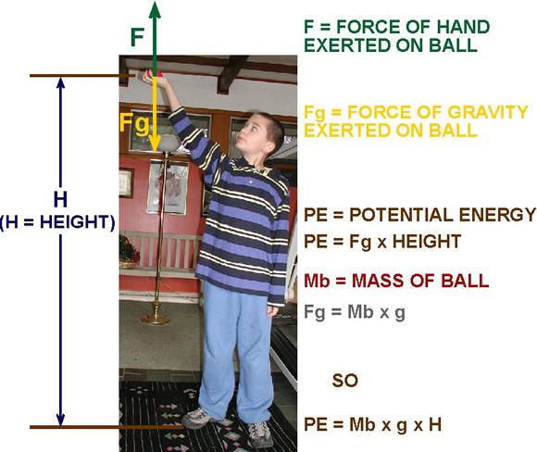
15.1Gravitational PE
This PE increases when you raise an object to a higher level.

Slide 7
15.1 Gravitational PE
PE = mgh
Mass should be in kg
Height should be in m
What is g?

Slide 8
15.1 Gravitational PE
Suppose a diver is on top of a 10 m platform and has a mass of 50 kg. What is her PE relative to the ground?

Slide 9
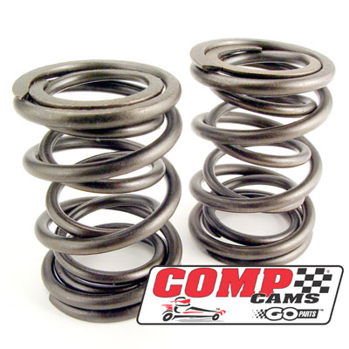
15.1 Elastic PE
Happens when something is stretched or compressed.
Rubber bands and compressed air in a basketball are examples of elastic PE.

Slide 10
Forms of energy
The major forms of energy are:
Mechanical energy – energy associated with motion and position of objects. Sum of an object’s KE and PE.
Thermal energy – total of PE and KE of an object’s microscopic particles.
Chemical energy – energy stored in chemical bonds in compounds.
Electrical energy – energy associated with electrical charges.
Electromagnetic energy – form of energy that travels through space in the form of waves.
Nuclear energy – energy stored in atomic nuclei.

Slide 11
15.2 Energy Conversion and conservation
Energy can be converted from one form to another.
We already saw this with PE and KE.
Think of a meteor falling through the sky.
The law of conservation of energy states that energy cannot be created or destroyed.
What happens when you stop pedaling on a bike?

Slide 12
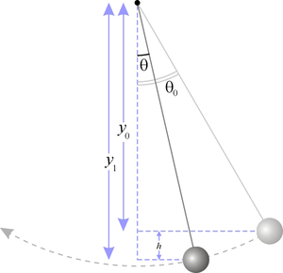
Most common energy conversions
Probably would be gravitational PE being converted to KE as something falls.
Let’s look at a pendulum:

Slide 13
Energy conversion calculations
Remember Mechanical energy = KE + PE
Because of the law of conservation of energy:
(KE + PE)_{beginning} = (KE + PE)_{end}

Slide 14
Problem
At a construction site, a 1.5 kg brick is dropped from rest and hits the ground with a speed of 26 m/s. Assuming air resistance can be ignored, calculate the gravitational potential energy of the brick before it was dropped.

Slide 15
Energy and mass
If we were to continue on with all of this, we would see that Einstein’s equation, E = mc² says that energy and mass are equivalent and can be converted into each other.
This is where it can get really fun!!!
Atomic fission is based on this principle.

Slide 16
15.3 Energy Resources
What are nonrenewable energy resources?
What are renewable energy resources?

Slide 17
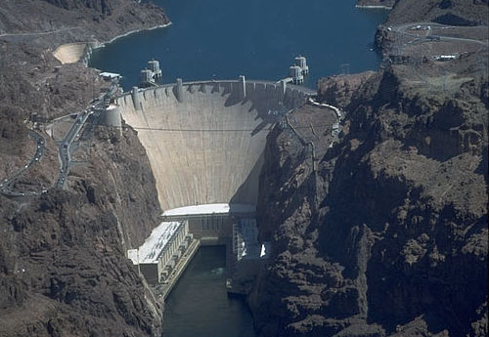
Examples of renewable energy sources
Hydroelectric

Slide 18
Solar energy

Slide 19
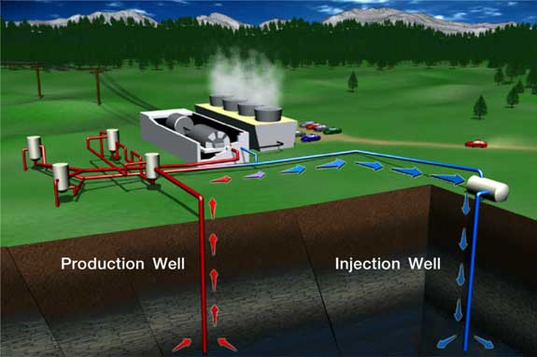
Geothermal energy
The heat beneath the Earth’s surface is used to generate electricity.
Its nonpolluting, but it is not widely available.

Slide 20
Other sources
Hydrogen fuel cells
Biomass energies
Ethanol
Biodiesel
New types being considered all the time

Slide 21
Review assignment
Pick a form of alternative energy production we talked about (or one we didn’t talk about) and write 250 words on how the energy is converted, the benefits of using it, and the disadvantages of using it at the present time.

