Slide 1
Physical Science
Chapter 17: Mechanical Waves and Sound

Slide 2
17.1 Mechanical Waves
A disturbance in matter that carries energy from one place to another is a mechanical wave.
Waves carry energy.
Require matter to travel through.
Material through which a wave travels is called a medium.

Slide 3
How are they created?
Mechanical waves created when a source of energy causes a vibration to travel through a medium.
Solids, liquids, and gases can all act as a medium.
In a pool, water acts as the medium. With a rope, the rope acts as a medium.

Slide 4
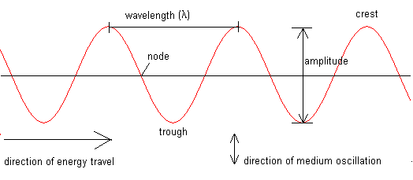
Types of Mechanical Waves
Three main types: Transverse, Longitudinal, and Surface.
Transverse – causes medium to vibrate at right angles to the direction in which the wave travels.

Slide 5
Longitudinal Waves
A wave in which the vibration of the medium is parallel to the direction the wave travels.
Compression – area where particles in medium are spaced close together.
Rarefaction – area where particles are spread out.
Let’s look at a spring.

Slide 6
Surface Waves
A wave that travels along a surface separating two media.
In the ocean, a ship bobs up and down with the wave, but it does not move closer to the shore (due to the wave action).
In shallow water, the waves topple over onto each other, and things like boats (or seaweed) can be carried into the shore.

Slide 7
17.2 Properties of mechanical waves
Waves exhibit periodic motion – any motion that repeats at regular time intervals.
The time required for one cycle - period.
Any periodic motion has a frequency – the number of complete cycles in a given time.
Frequency measured in cycles/ second, or hertz (Hz).
A wave’s frequency equals the frequency of the vibrating source producing the wave.

Slide 8
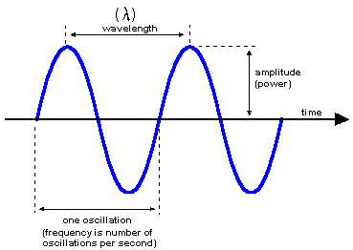
Wavelength
It’s the distance between a point on one wave and the same point on the next cycle of the wave.

Slide 9
Frequency and Wavelength
Increasing the frequency of a wave decreases its wavelength.

Slide 10
Wave speed
Remember speed = distance/ time
We can calculate the speed of a wave by dividing its wavelength (distance a wave travels) by its period (the time it takes for one cycle of a wave). We can also get the speed by taking wavelength times frequency.
Speed = wavelength (m) x frequency ( /sec)

Slide 11
Wave Speed
V = x frequency
One end of a rope is vibrated to produce a wave with a wavelength of .25 meters. The frequency of the wave is 3.0 hertz. What is the speed of the wave?

Slide 12
Wave Speed
The speed of a wave can change if:
It enters a new medium
Pressure changes
Temperature changes
For many waves, the speed of the wave is roughly constant for a range of different frequencies.
If the wave is traveling at a constant speed, the wavelength is inversely proportional to frequency. (The wave with the lower frequency will have a longer wavelength.)

Slide 13
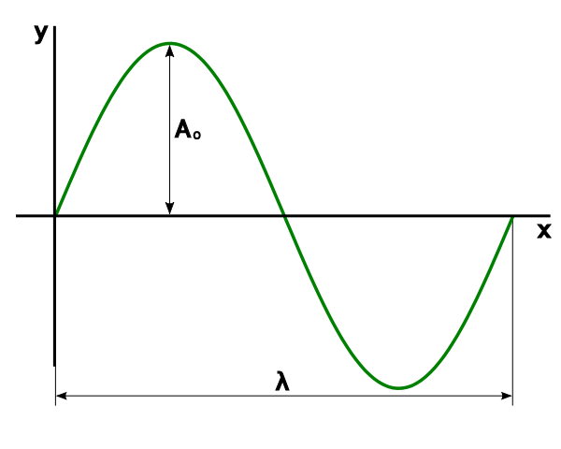
amplitude
Dropping a pebble into a pond vs. doing a cannonball into the same pond: differences in wave amplitude.
Amplitude – maximum displacement of the medium from its rest position.
The more energy a wave has, the greater its amplitude.

Slide 14
17.3 Behavior of waves
As waves crisscross back and forth, many actions can occur.
Reflection
Refraction
Diffraction
Interference
Constructive
Destructive

Slide 15
Reflection
Occurs when a wave bounces off a surface that it cannot pass through.
Doesn’t change speed or frequency, but can flip a wave upside down. (If it occurs at a fixed boundary, like a wall)

Slide 16
Refraction
Bending of a wave as it enters a new medium at an angle.
One side of wave moves more slowly than other side.

Slide 17
Diffraction
Bending of a wave as it moves around an obstacle.

Slide 18
interference
Constructive – larger displacement Destructive – smaller displacement

Slide 19
Standing wave
Wave that appears to stay in one place – it does not seem to move through the medium
Node – point on a standing wave that has no displacement from the rest position. (Complete destructive interference between incoming and reflected waves.)
Antinode – point where a crest or trough occurs midway between two nodes.
Standing waves form only if half a wavelength or a multiple of half a wavelength fits exactly into the length of a vibrating cord.

