Slide 1
Technology
Adventure
By mrs. Van’s class

Slide 2
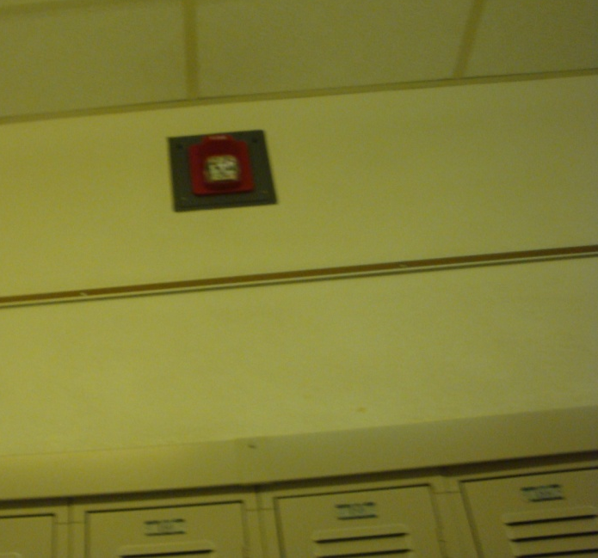
The fire alarm rings and we line and follow mrs. Van outside. It helps us be safe.

Slide 3
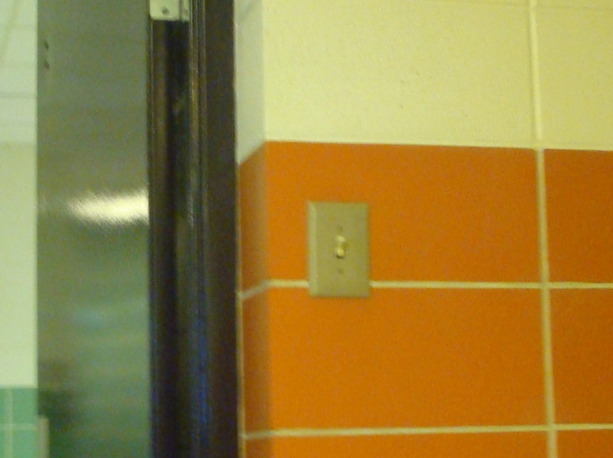
The light switch turns on and off the lights. It saves electricity when it is off.

Slide 4
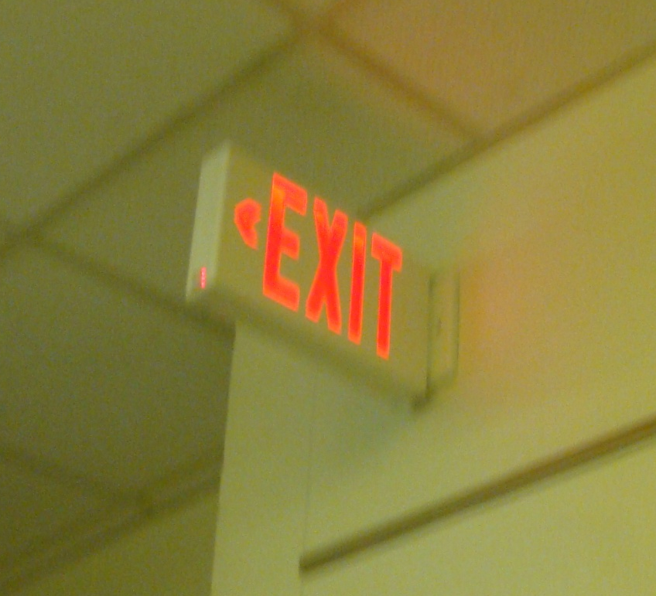
This is an exit sign. It helps us get out in case there’s a fire.

Slide 5
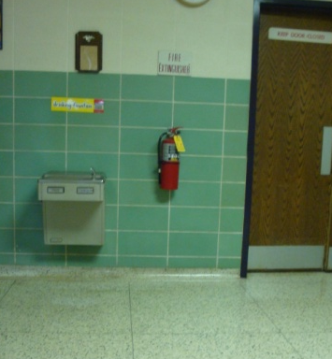
The fire extinguisher helps put out fires.

Slide 6

The clock helps us tell time.

Slide 7
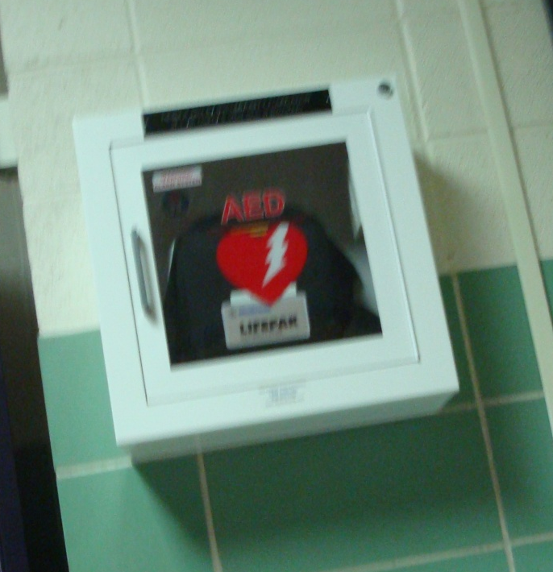
The defribulator helps our heart keep going if it stops.

Slide 8
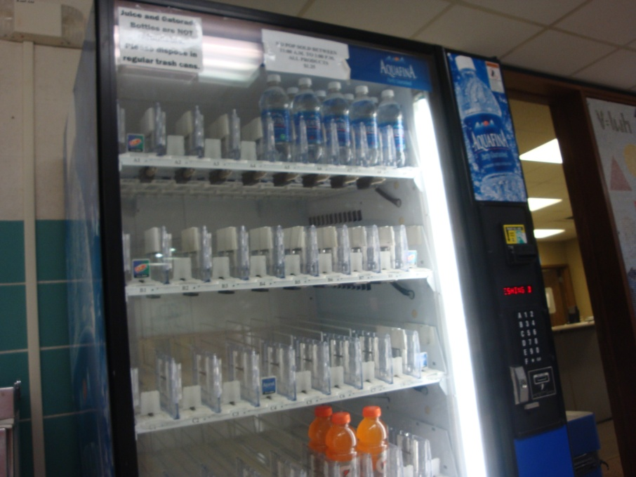
The beverage machine helps give us drinks that are cold.

Slide 9
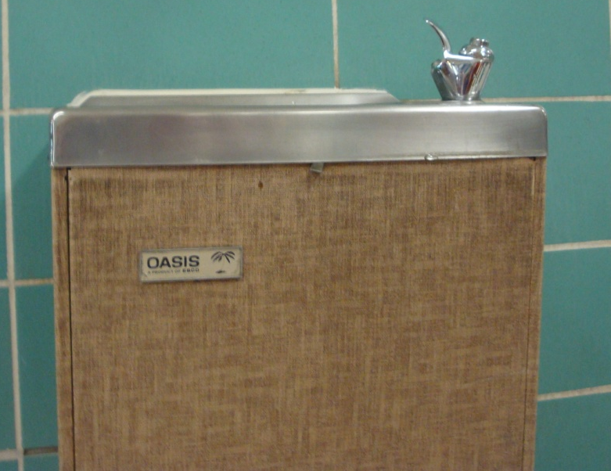
The water fountain gives us cold water to drink.

Slide 10
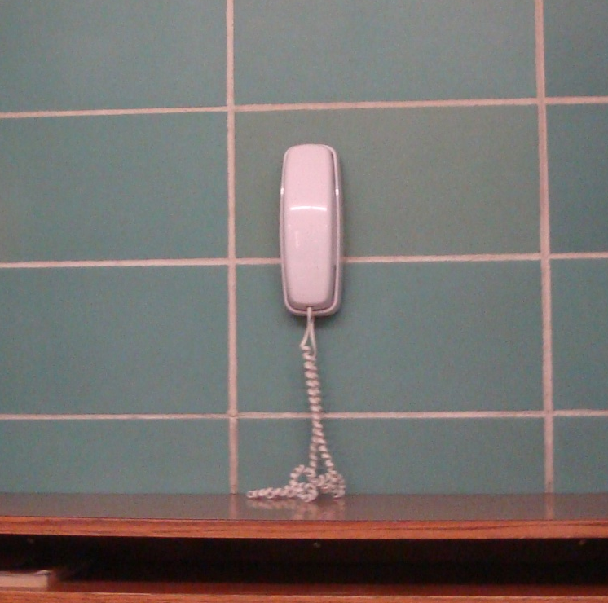
The telephone helps us to call someone.

Slide 11
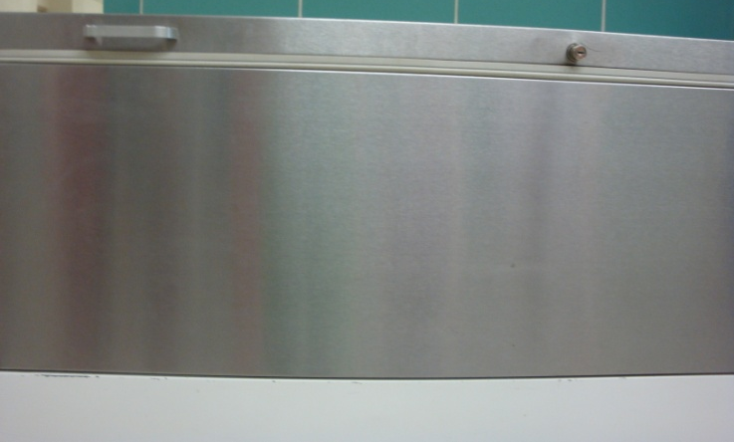
The milk cooler keeps our milk cold.

Slide 12
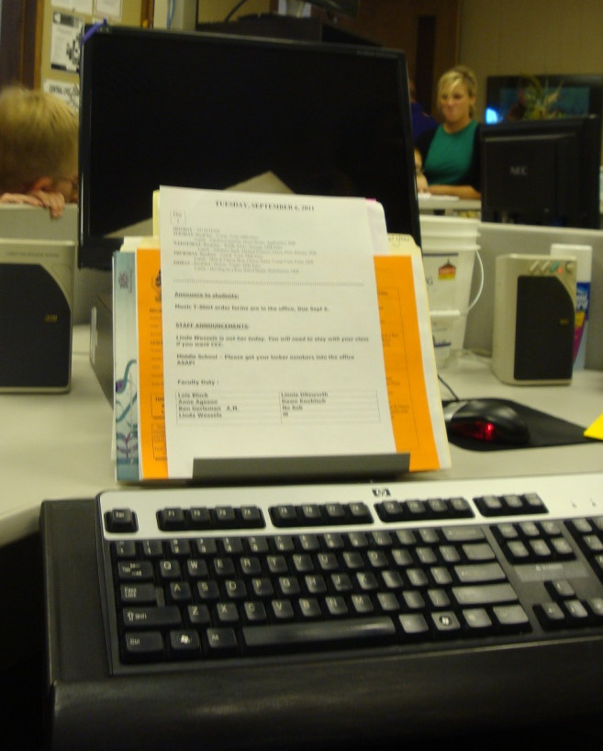
The computer helps us do our work and we can play games on them.

Slide 13
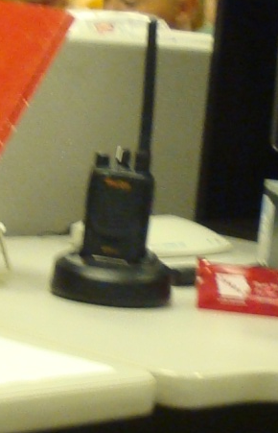
The walkie talkie helps us to talk to someone when they are far away.

Slide 14
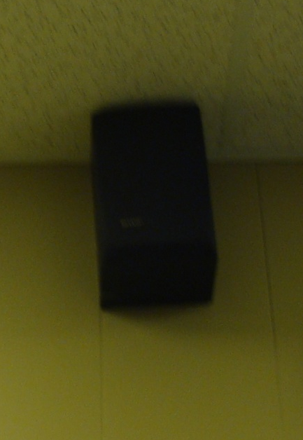
The speaker helps us to hear better.

Slide 15
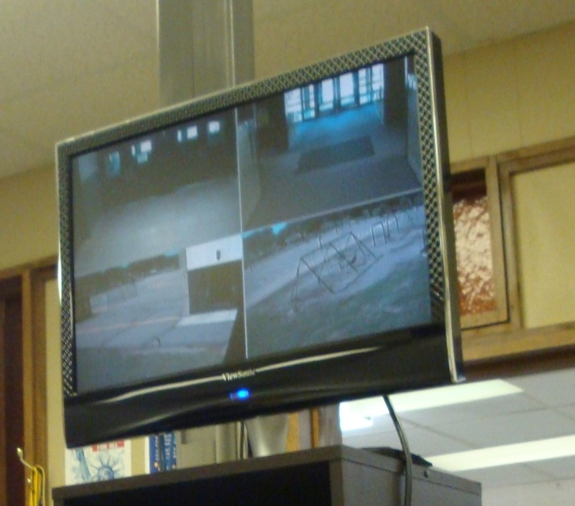
The camera screen helps kay and rhonda see what’s going on in school.

Slide 16
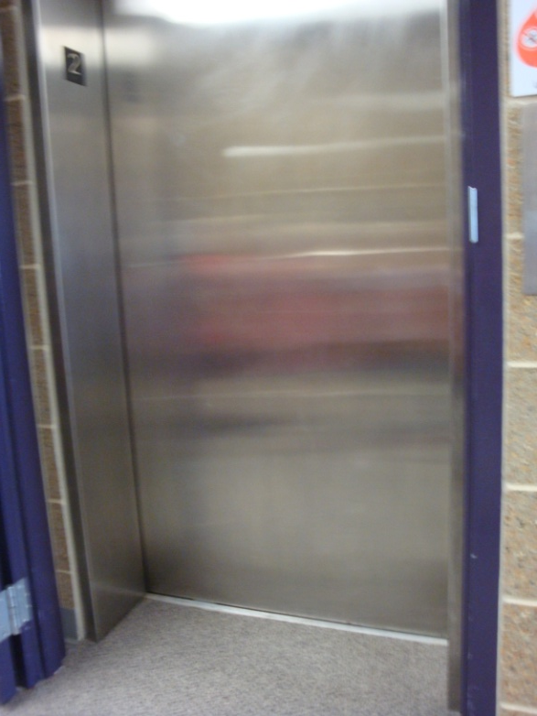
The elevator helps us go down and up so we don’t have to use the stairs.

Slide 17
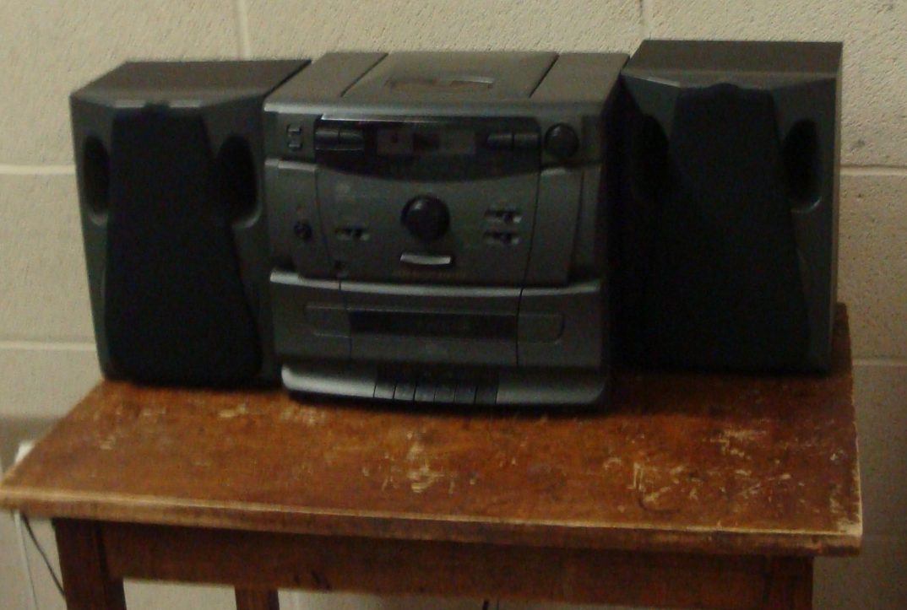
The radio helps us listen to music and the news.

Slide 18
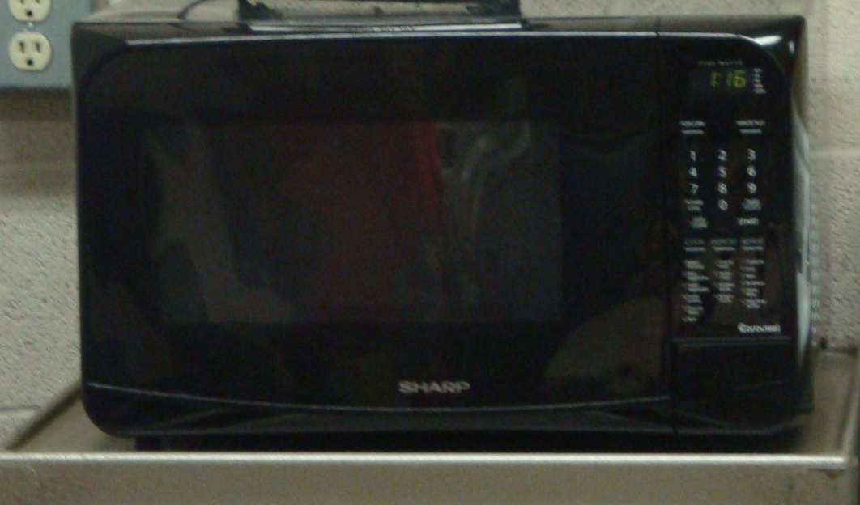
The microwave helps us warm up food.

Slide 19
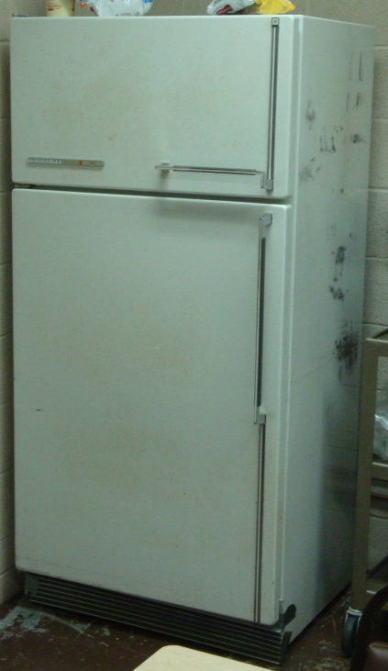
The refrigerator helps keep our food cold.

Slide 20
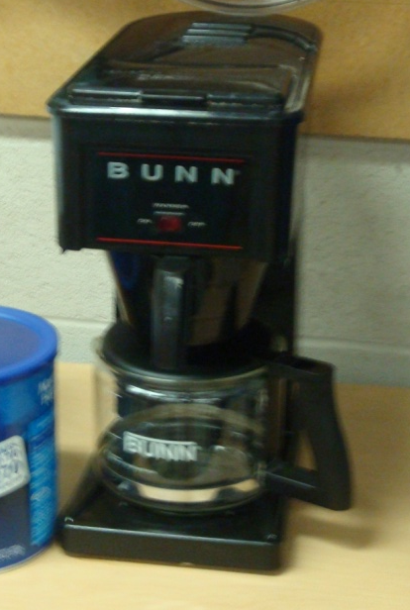
The coffee maker helps us make coffee.

Slide 21
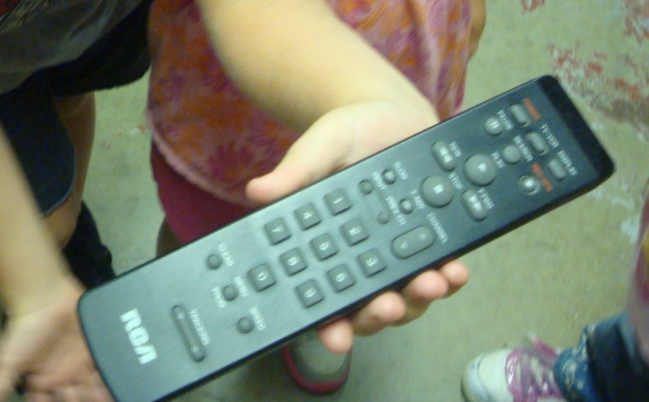
The remote control helps us change the channel on our tv.

Slide 22
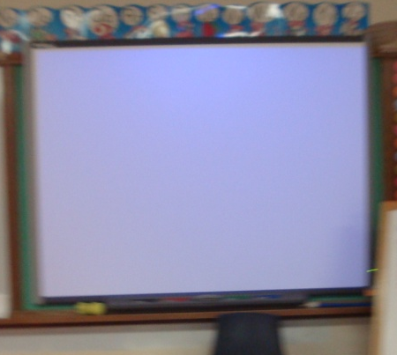
The smart board helps us learn.

Slide 23
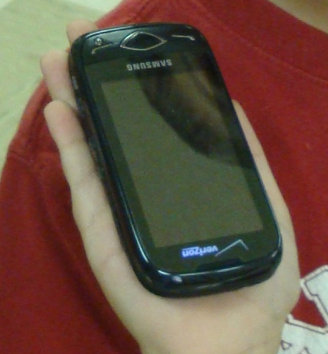
Cell phones help us talk to people.

