Slide 1
Chapter 13: Education and Religion
Case Study: Religion in Public Schools
Section 1: The Sociology of Education
Section 2: Issues in American Education
Section 3: The Sociology of Religion
Section 4: Religion in American Society
Lab: Applying What You’ve Learned

Slide 2
Case Study: Religion in Public Schools
Parents have the primary responsibility of caring for their children, and they often share religious worship with their children. But by common belief, failing to educate a child to fully participate in society constitutes harm, so the government requires children to attend school. What happens when the government attempts to teach lessons that parents or students object to on religious grounds? The First Amendment clearly states that the government will not create a state religion, but court judges are in charge of the interpretation in specific cases. Court cases have resulted in the banning of voluntary prayer times.

Slide 3
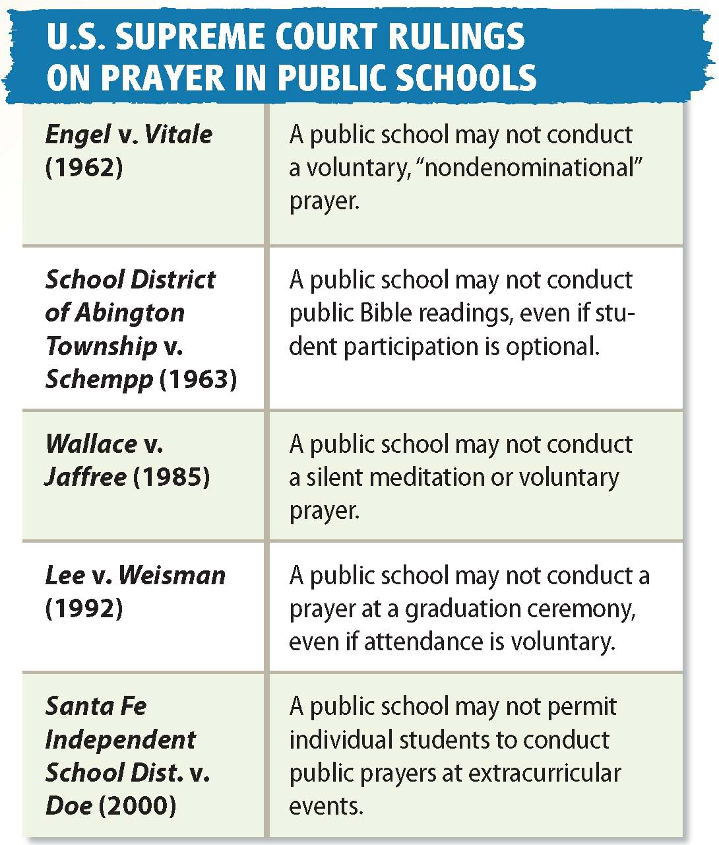

Slide 4
Section 1 at a Glance
The Sociology of Education
Education consists of the norms and roles involved in transmitting knowledge, values, and patterns of behavior from one generation to the next.
Sociologists have gained insight into education by studying it from functionalist, conflict, and interactionist perspectives.

Slide 5
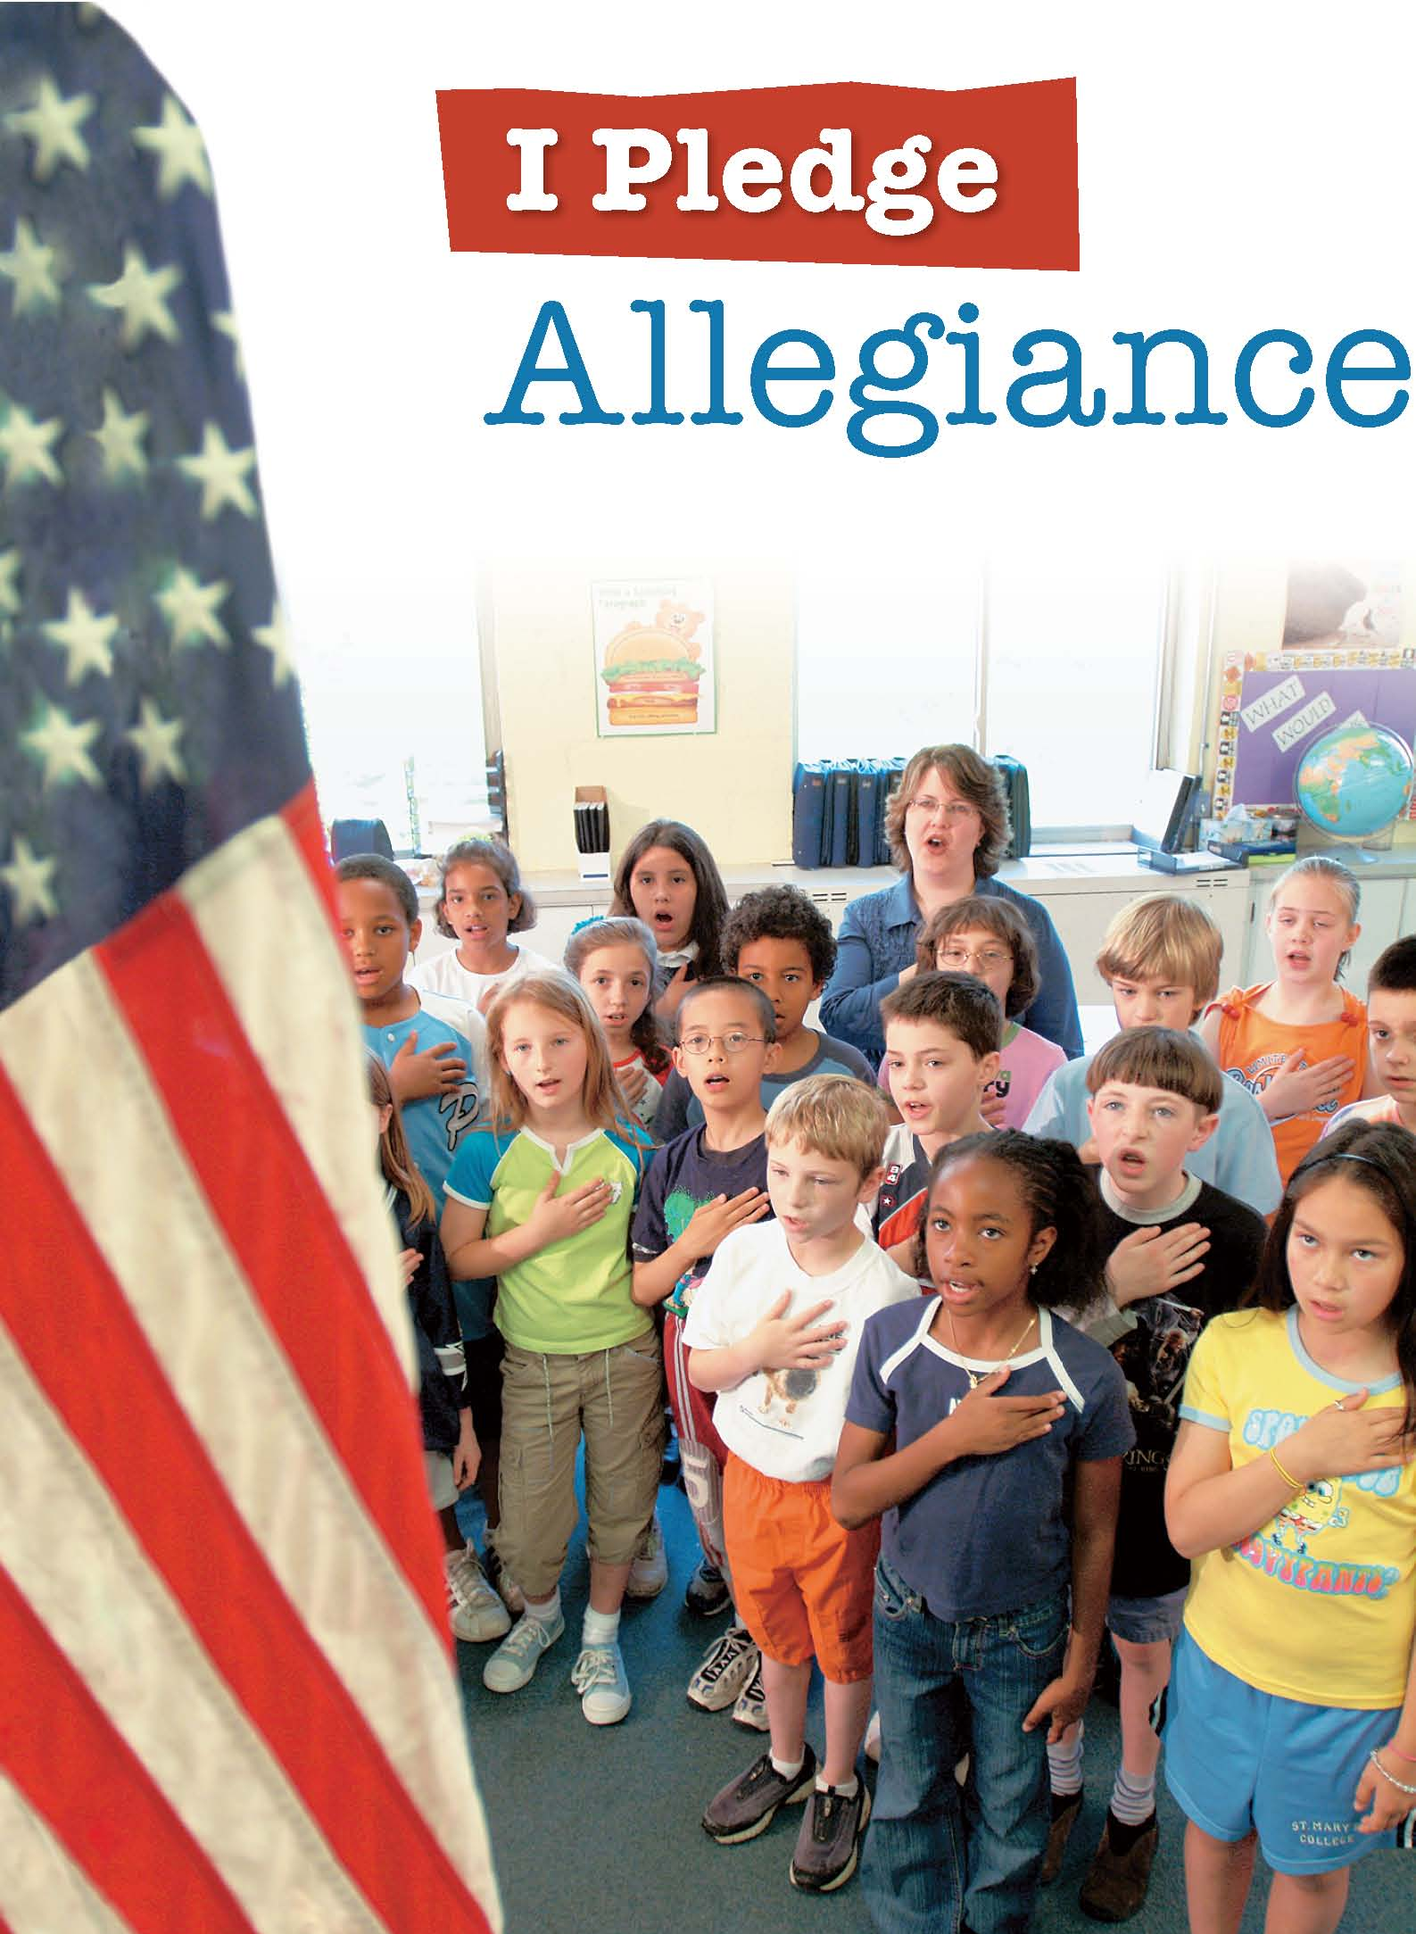
How do we learn what it means to be American?

Slide 6
Defining Education
A society’s future largely depends on the successful socialization of new members. To accomplish this goal, every society has developed a system of education consisting of the roles and norms that ensure the transmission of knowledge, values, and patterns of behavior from one generation to the next.
In some preindustrial societies, education is largely informal and occurs mainly within the family.
Schooling is formal education, which involves instruction by specially trained teachers who follow officially recognized policies.

Slide 7
Defining Education
Functionalist view: Studies the ways in which education aids society
Conflict view: Studies the ways in which education maintains the imbalance of power in society
Interactionist view: Studies the face-to-face interaction of the classroom.

Slide 8
The Functionalist Perspective on Education
Teaching Knowledge and Skills
Children must learn the knowledge and skills they will need as adults.
Education generates new knowledge, which is useful in adapting to changing conditions.
Transmission of Culture
For societies to survive, they must pass on core values of their culture.
Societies use education to support their communities’ social and political system.
Social Integration
Education serves to produce a society of individuals who share a common national identity.
Schools foster social integration and national unity by teaching a core set of skills and values.
Occupational Placement
Education screens and selects the members of society for the work they will do as adults.
Schools in industrialized countries identify students who show special talents and abilities at an early age.

Slide 10
The Conflict Perspective on Education
Education serves to sort students into social ranks and to limit the potential of certain individuals and groups to gain power and social rewards.
Students’ achievement or failure tend to reflect existing inequalities.
Social Control
Schools produce unquestioning citizens who accept the basic inequalities of the social system.
Hidden curriculum: Schools’ transmission of cultural goals that are not openly acknowledged.
Tracking
Tracking: Involves the assignment of students to different types of educational programs
Classroom instructions used in the different tracks serve to reproduce the status quo.
Education and Socioeconomic Status
Opportunities for educational success are distributed unequally.
Higher-status college students outnumber lower-status college students.

Slide 11
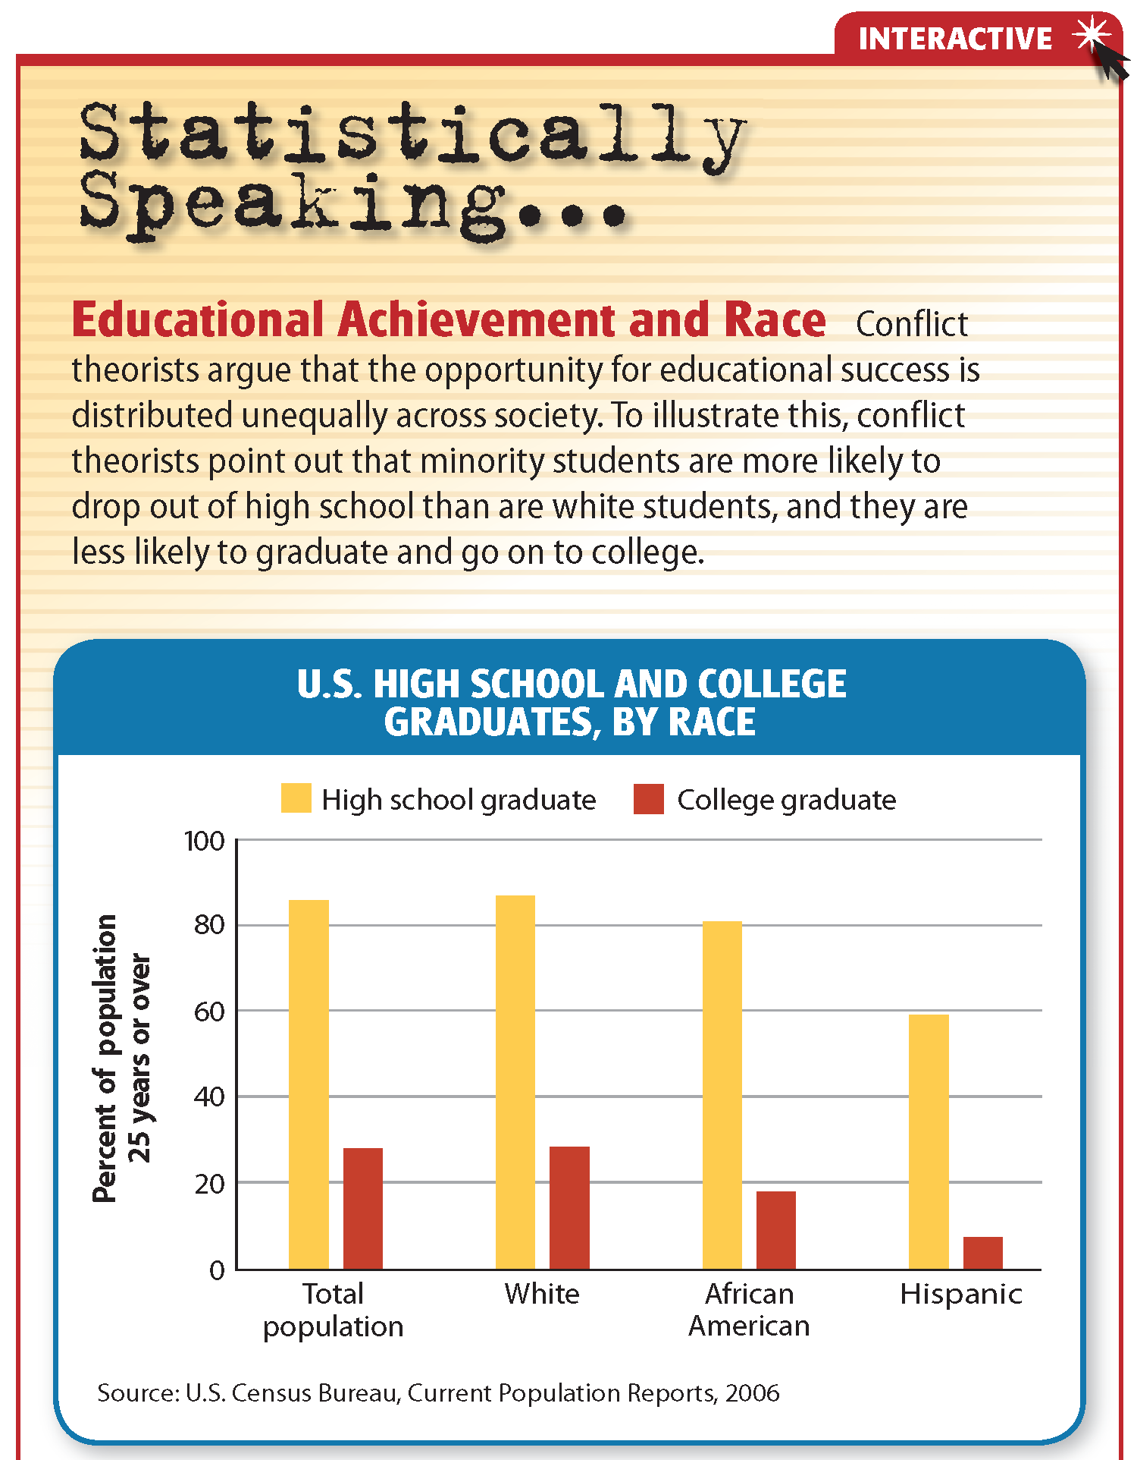
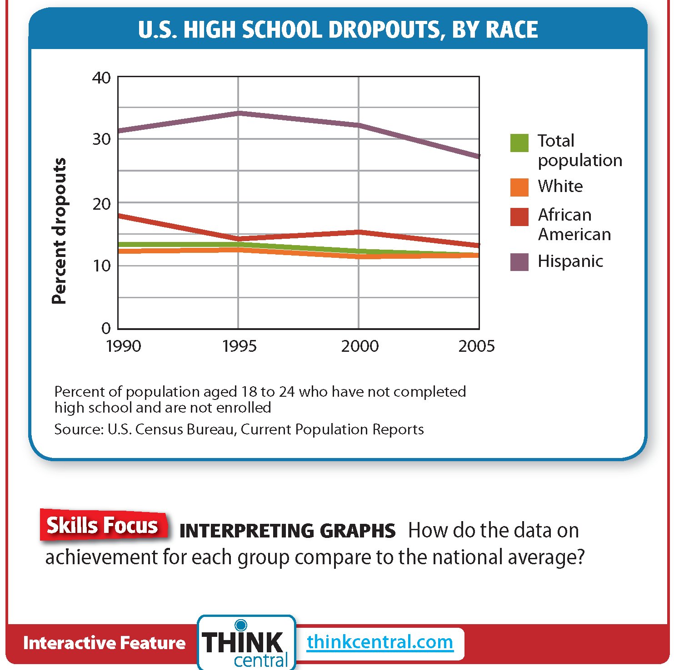
Click on the image below to play the Interactive.

Slide 12
The Interactionist Perspective on Education
Student-Teacher Interaction
Students labeled fast learners or slow learners without any data eventually took on the characteristics of the label.
A self-fulfilling prophecy is a prediction that leads to behavior that makes the prediction come true.
When teachers treat students as if they are bright and capable, the students begin to think of themselves in this way, and vice versa.
Interactions among Students
The Coleman Report found that the socioeconomic status of fellow students was the most significant factor in explaining student success.
Peer pressure may be a factor in this dynamic.

Slide 14
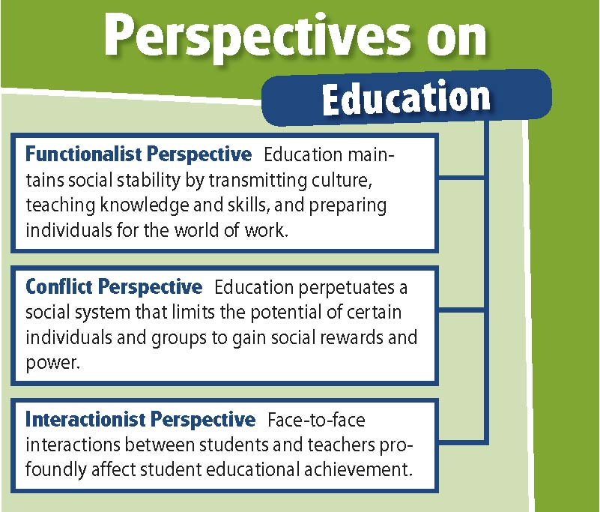

Slide 15
Section 2 at a Glance
Issues in American Education
Americans have tried to reform education in order to achieve broad and important social goals.
Alternatives to the traditional public school system include private and charter schools, school choice, and home schooling.
Violence in schools is a serious social concern.
Methods and curricula for teaching English to non-native speakers are highly controversial.

Slide 16
How do schools contribute to social justice?

Slide 17
Educational Reform
History of Reform
In the early part of the 1900s education concerns centered on the assimilation of immigrants.
In the mid-1900s Americans looked to education to win the space race.
After 1983 education focused on comparing American students to those in other nations.
Although many overhauls occurred, reforms brought little progress.
The improvement goals originally planned for 2000 were not met.
No Child Left Behind
2001 law with benchmarks for improving schools.
Provided money for schools to improve teaching.
Made standardized test scores the measure of how a school was performing.
Extra emphasis on early reading instruction and teacher preparation.
Although test scores have risen, some claim that higher-order thinking skills have been neglected.

Slide 20
Alternatives to Public Schools
Charter schools: Funded with public money but are privately operated and run.
The charter establishes the amount of public funding the school will receive.
School choice: Parents may receive a voucher equal to the amount their state spends on education for their child that they can put toward the tuition at a private, charter, or religious school.
Homeschooling: A system in which a child’s main education is undertaken by parents at home.
Critics of homeschooling claim that it may not provide a broad enough curriculum or necessary social interaction.

Slide 21
Violence in the Schools
A 2006 survey showed that only 75 percent of parents believed their public schools were “very” or “somewhat” safe.
Such fears are generated by violent incidents such as the Columbine High School shootings.
In 2005 about 10 percent of boys and 3 percent of girls were threatened or injured by a weapon at school.
Schools seem to be safer for students than being off campus.
Zero tolerance policies involve set punishments—often expulsion—and no leniency for serious offenses such as carrying a weapon, committing a violent act, or possessing drugs or alcohol.
Some educators believe that the best way to curb school violence is to teach young people how to resolve disputes peacefully.

Slide 22
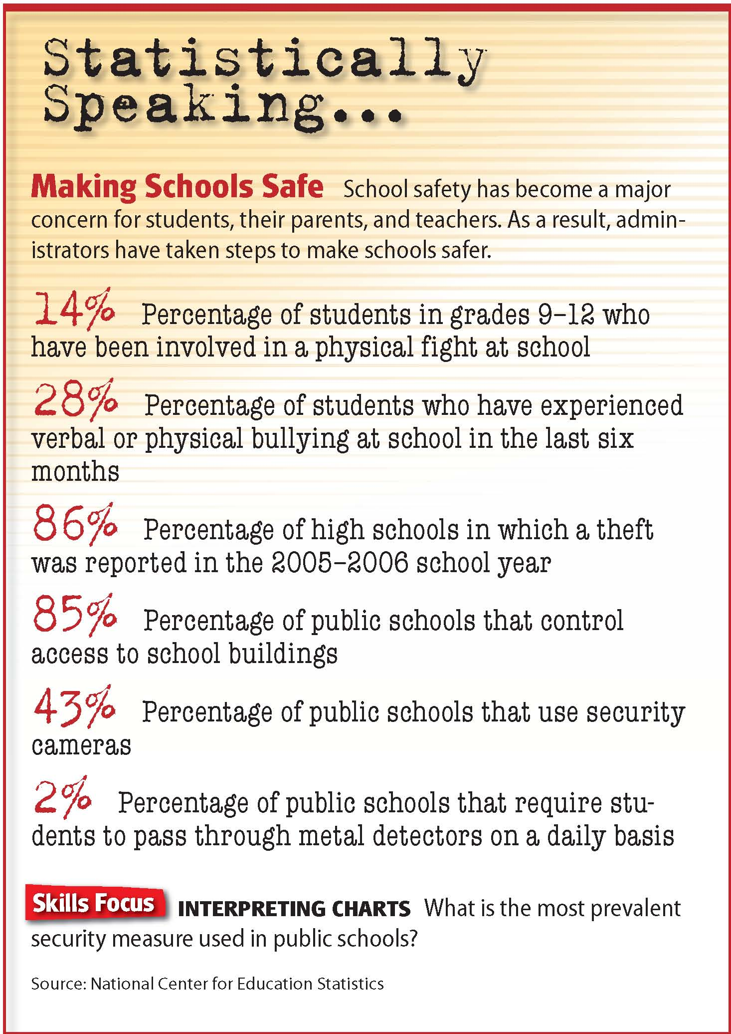

Slide 23
English as a Second Language
Bilingual education: a system in which non-English-speaking students study science, math, and other subjects in their native languages until they gain fluency in English.
Bilingual education has had the support of many educators, but the plan has been opposed by those who believe that it interferes with cultural assimilation.
In 1998 a citizens’ initiative made bilingual education illegal in California.
As of 2008, 30 states have laws making English their officially recognized language.

Slide 24
Sociology in Today’s World
Alternative Education
Interest in alternative schooling methods has led to three distinctive styles of alternative schooling: the free school movement, magnet schools, and back-to-basics curricula.
Free school: Schools should encourage creativity by allowing students to learn through exploration and experimentation.
Magnet school: Schools with distinct features intended to attract students from across a district.
Back-to-basics curricula: Programs are designed to prepare failing or at-risk students for their return to mainstream schools.
First two types designed as a way to change schooling, third type designed as a substitute.
Some longtime supporters are concerned that the third style has become dominant.
Notes:
–

Slide 25
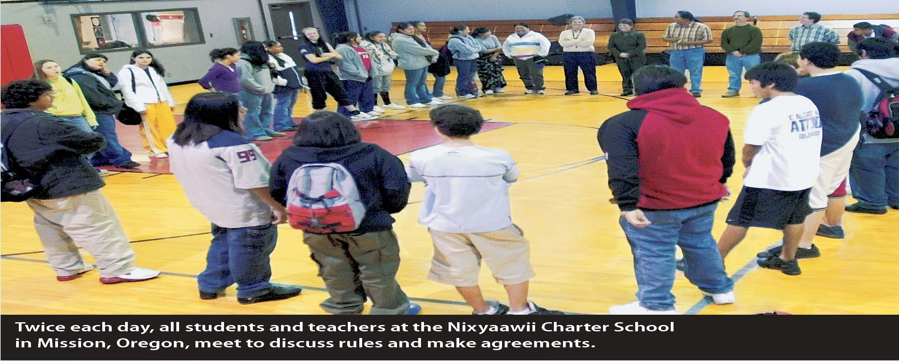

Slide 26
Thinking Critically
What three movements in alternative schooling developed in the 1960s and 1970s?
Do you think alternative education as defined by Dr. Robert Fizzell is needed in the United States?

Slide 27
Section 3 at a Glance
The Sociology of Religion
A religion is a system of roles and norms organized around the sacred, which binds people together in groups.
Religions can provide social cohesion, social control, and emotional support.
Religions are characterized by their rituals, symbols, belief systems, and organizational structures.

Slide 28
What does religion mean to you?

Slide 29
Religion—A Sociological Definition
Societies have struggled with the need to give meaning to human existence and to provide people with the motivation for survival.
Societies make distinctions between the sacred (anything that is considered to be part of the supernatural world and that inspires awe, respect, and reverence) and the profane (anything considered to be part of the ordinary world and, thus, commonplace and familiar).
This distinction is the basis for of all religions (systems of roles and norms that are organized around the sacred realm and that bind people together in social groups).
Religion is a basic institution, yet it exists in many different forms because different societies give sacred meaning to a wide variety of objects, events, and experiences.
Belief in a particular religion is based on faith rather than on science.

Slide 30
The Functions of Religion
Social Cohesion
Strengthens bonds between people
Can lead to conflict between adherents of different religions
Social Control
Encourages conformity to norms
Provides a divine purpose for conformity
May inhibit innovation, freedom of thought, and social reform
Emotional Support
Helps people endure disappointment and suffering by providing a comfort in believing that harsh circumstances have a special purpose
Attempts to provide answers to the questions concerning life and death

Slide 31
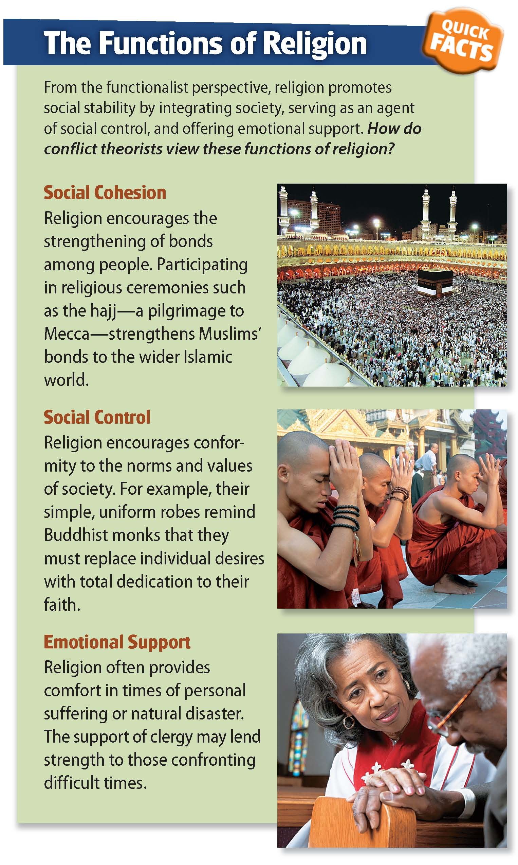

Slide 32
The Nature of Religion
Rituals and Symbols
Ritual: An established pattern of behavior through which a group of believers experiences the sacred
Often used to mark changes in status such as birth, marriage, and death
Also used to unite believers and reinforce faith
Often includes sacred symbolic objects—such as clothing, herbs, chalices, or books
Belief Systems
Animism: Belief that spirits actively influence human life; two kinds: shamanism and totemism
Theism: Belief in god or gods; two kinds: monotheism and polytheism
Monotheism: The belief in one god, who is usually seen as the creator and moral authority
Polytheism: Belief in a number of gods
Ethicalism: The idea that moral principles have a sacred quality

Slide 33
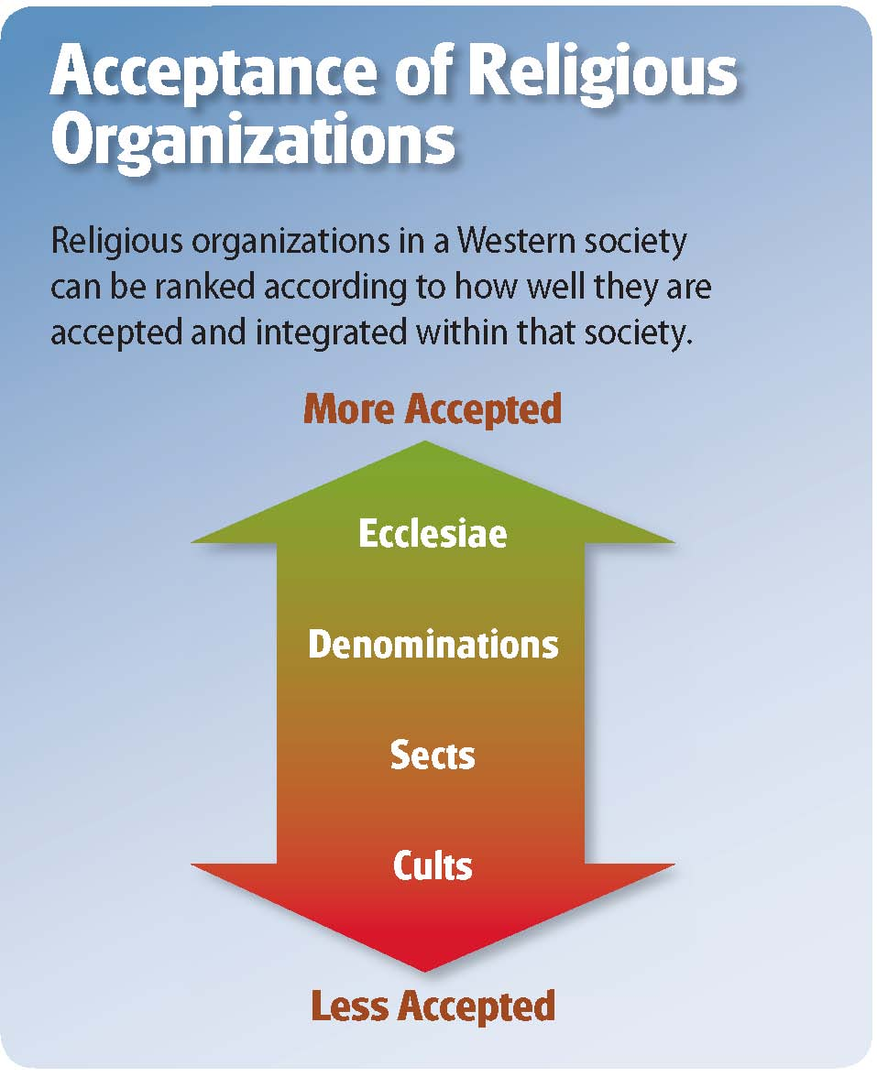
Organizational Structures
Ecclesia: Structured bureaucratic organization, closely allied with the government, whose officials are highly trained and wield considerable power
Denomination: Well-established religious organization in which a substantial number of the population are members
Sect: Relatively small religious organization that typically has split off from a denomination because of differences concerning beliefs
Cult: New religion whose beliefs differ markedly from those of the society’s major religions

Slide 34
Section 4 at a Glance
Religion in American Society
A vast majority of Americans believe in God and consider themselves affiliated with a religion.
American religions are organized into more than 400 denominations.
About half of Americans consider themselves religious and consider religious teachings when making decisions.

Slide 35
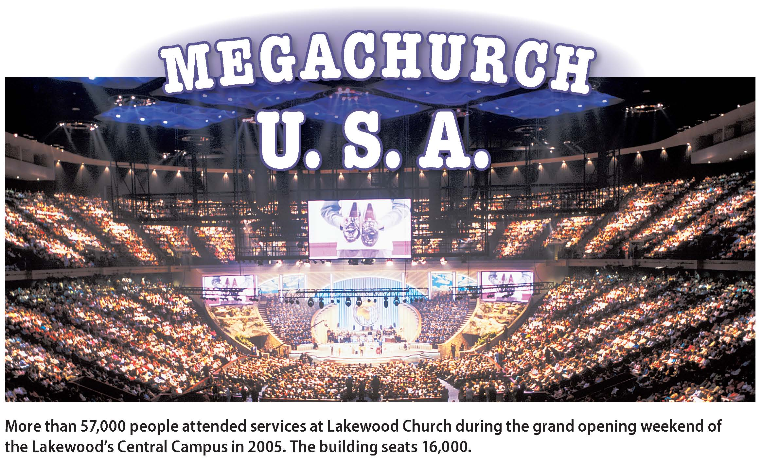
Why do some church services look like rock concerts?

Slide 36
Religion in the United States
Freedom of religion is protected by law and supported by popular opinion.
The United States is home to hundreds of religious denominations, sects, and cults.
Immigrants often bring new religions.
The general opinion in the U.S. is that all people should hold some religious beliefs.
Separation of church and state means the U.S. has no national religion.
Rise of fundamentalist Christianity has become a topic of study.
Most Americans belong to one of the major faiths, with the majority being Protestant Christians. Demographic differences among religious groups exist.

Slide 38
Religious Participation
Although the majority of Americans claim a religious preference, only about one-third of people attend religious services on a regular basis.
Religiosity
Secular
Religiosity is the depth of people’s religious feelings
Hard to measure
Depth of feeling does not correlate with participation in services
Secular refers to the non-religious aspects of society
Decisions based equally on religious teaching and own beliefs
Notes:
–

Slide 39
Fundamentalist Christianity
Religious fundamentalism refers to a set of associated beliefs including strict adherence to the religion’s rules and practices and the belief that religion should be the primary force in one’s life.
A variety of fundamentalist Christian groups exist in the United States, but they share the beliefs that:
the Christian Bible is completely and literally true.
Jesus Christ is divine.
their faith will bring personal salvation—the “born-again” experience.
they are obligated to bring Jesus Christ into the lives of all nonbelievers.
26 percent of Americans describe themselves as “born-again” or evangelical Christians.
These Americans have become politically organized around certain issues such as opposition to abortion and homosexuality.

Slide 40
Cultural Diversity and Sociology
Religious Diversity in the United States
Since colonial times people have come to the United States to enjoy the freedom to worship how they please. Modern immigrants have helped transform the United States into the most religiously diverse country in the world.
Notes:
–

Slide 41
Cultural Diversity and Sociology
Christianity: First Protestants arrived in the 1600s and the country is today predominantly Christian
Buddhism: Chinese immigrants brought Buddhism during the mid-1800s and many non-Asian Americans have adopted it
Hinduism: Born in the ancient Indus Valley, today there are more than one million Hindus in the United States
Judaism: Founded about 2000 BC and practiced by 5 million Americans, a number comparable to the Jewish population of Israel
Islam: The religion of Muslims; there are more than 4.7 million Muslims in the United States
Other Religions: Sikhism, Baha’i, Taoism, Spiritualism, and diverse Native American and New Age faiths; 34 million claim no religion, and more than 1 million are atheists
Notes:
–

Slide 42
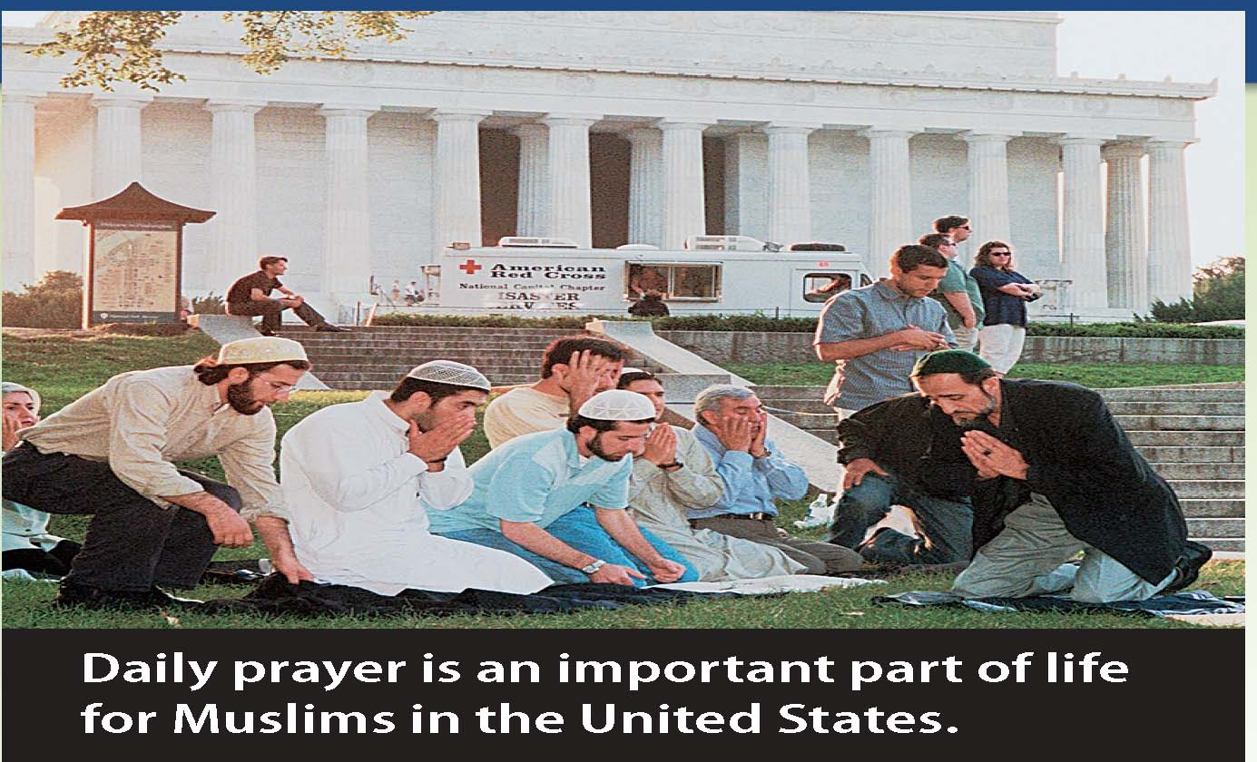

Slide 43
Thinking Critically
What effect has immigration had on religious diversity in the United States?
In what ways does the religious diversity of the United States affect society?

Slide 44
Lab: Applying What You’ve Learned
How One Society Dealt with Calamity
Investigate how Amish religious beliefs shape their norms and guide their behavior.
1. Introduction
In this lab you will investigate how the Amish adjust their education to accommodate their relations with the larger society.
Read the case study and work in a group on the assigned activity.
Notes:
–

Slide 45
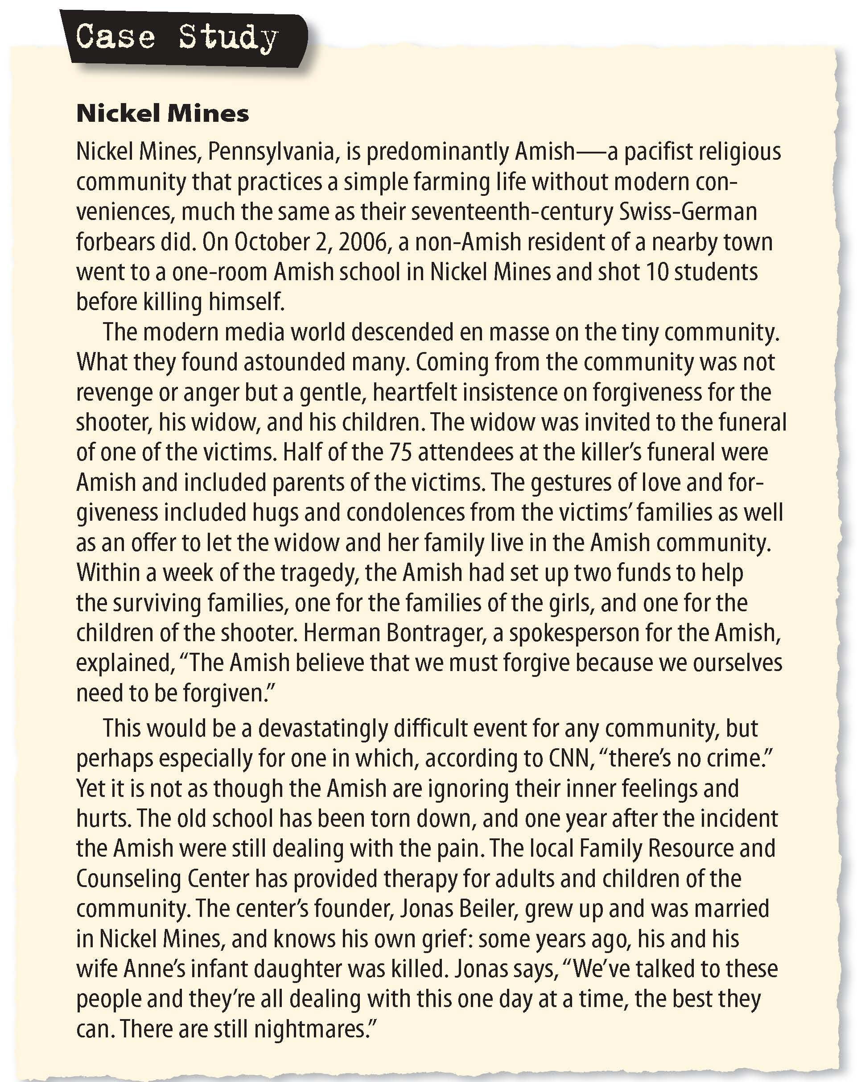
Lab: Applying What You’ve Learned
Notes:
–

Slide 46
Lab: Applying What You’ve Learned
Notes:
–

Slide 47
Lab (cont.)
2. Group Activities
Address the topics that are assigned by your teacher.
Answer the questions that are listed with each topic.
3. Discussion
What did you learn from this lab? As a group, discuss the following:
What were the findings of each group?
How did you come to a shared opinion?
What did group members disagree about?

