Slide 1
Chapter 14: Sport and the Mass Media
Case Study: Sport and Television: A Love Affair?
Section 1: Sport as a Social Institution
Section 2: Perspectives and Issues in American Sport
Section 3: Mass Media as a Social Institution
Section 4: Perspectives and Issues in Mass Media
Lab: Applying What You’ve Learned

Slide 2
Case Study: Sport and Television: A Love Affair?
Sociologist John Goldlust has suggested that the coming together of sport and television was a “match made in heaven.” Many sports have changed how, when, and where they are played because of the necessities of television. Tennis balls are yellow, for example, because that color is easier to see on television. Monetary profit has driven many of these changes, and the popularity of sports memorabilia and media has enabled many more people to make a living from sports.

Slide 3
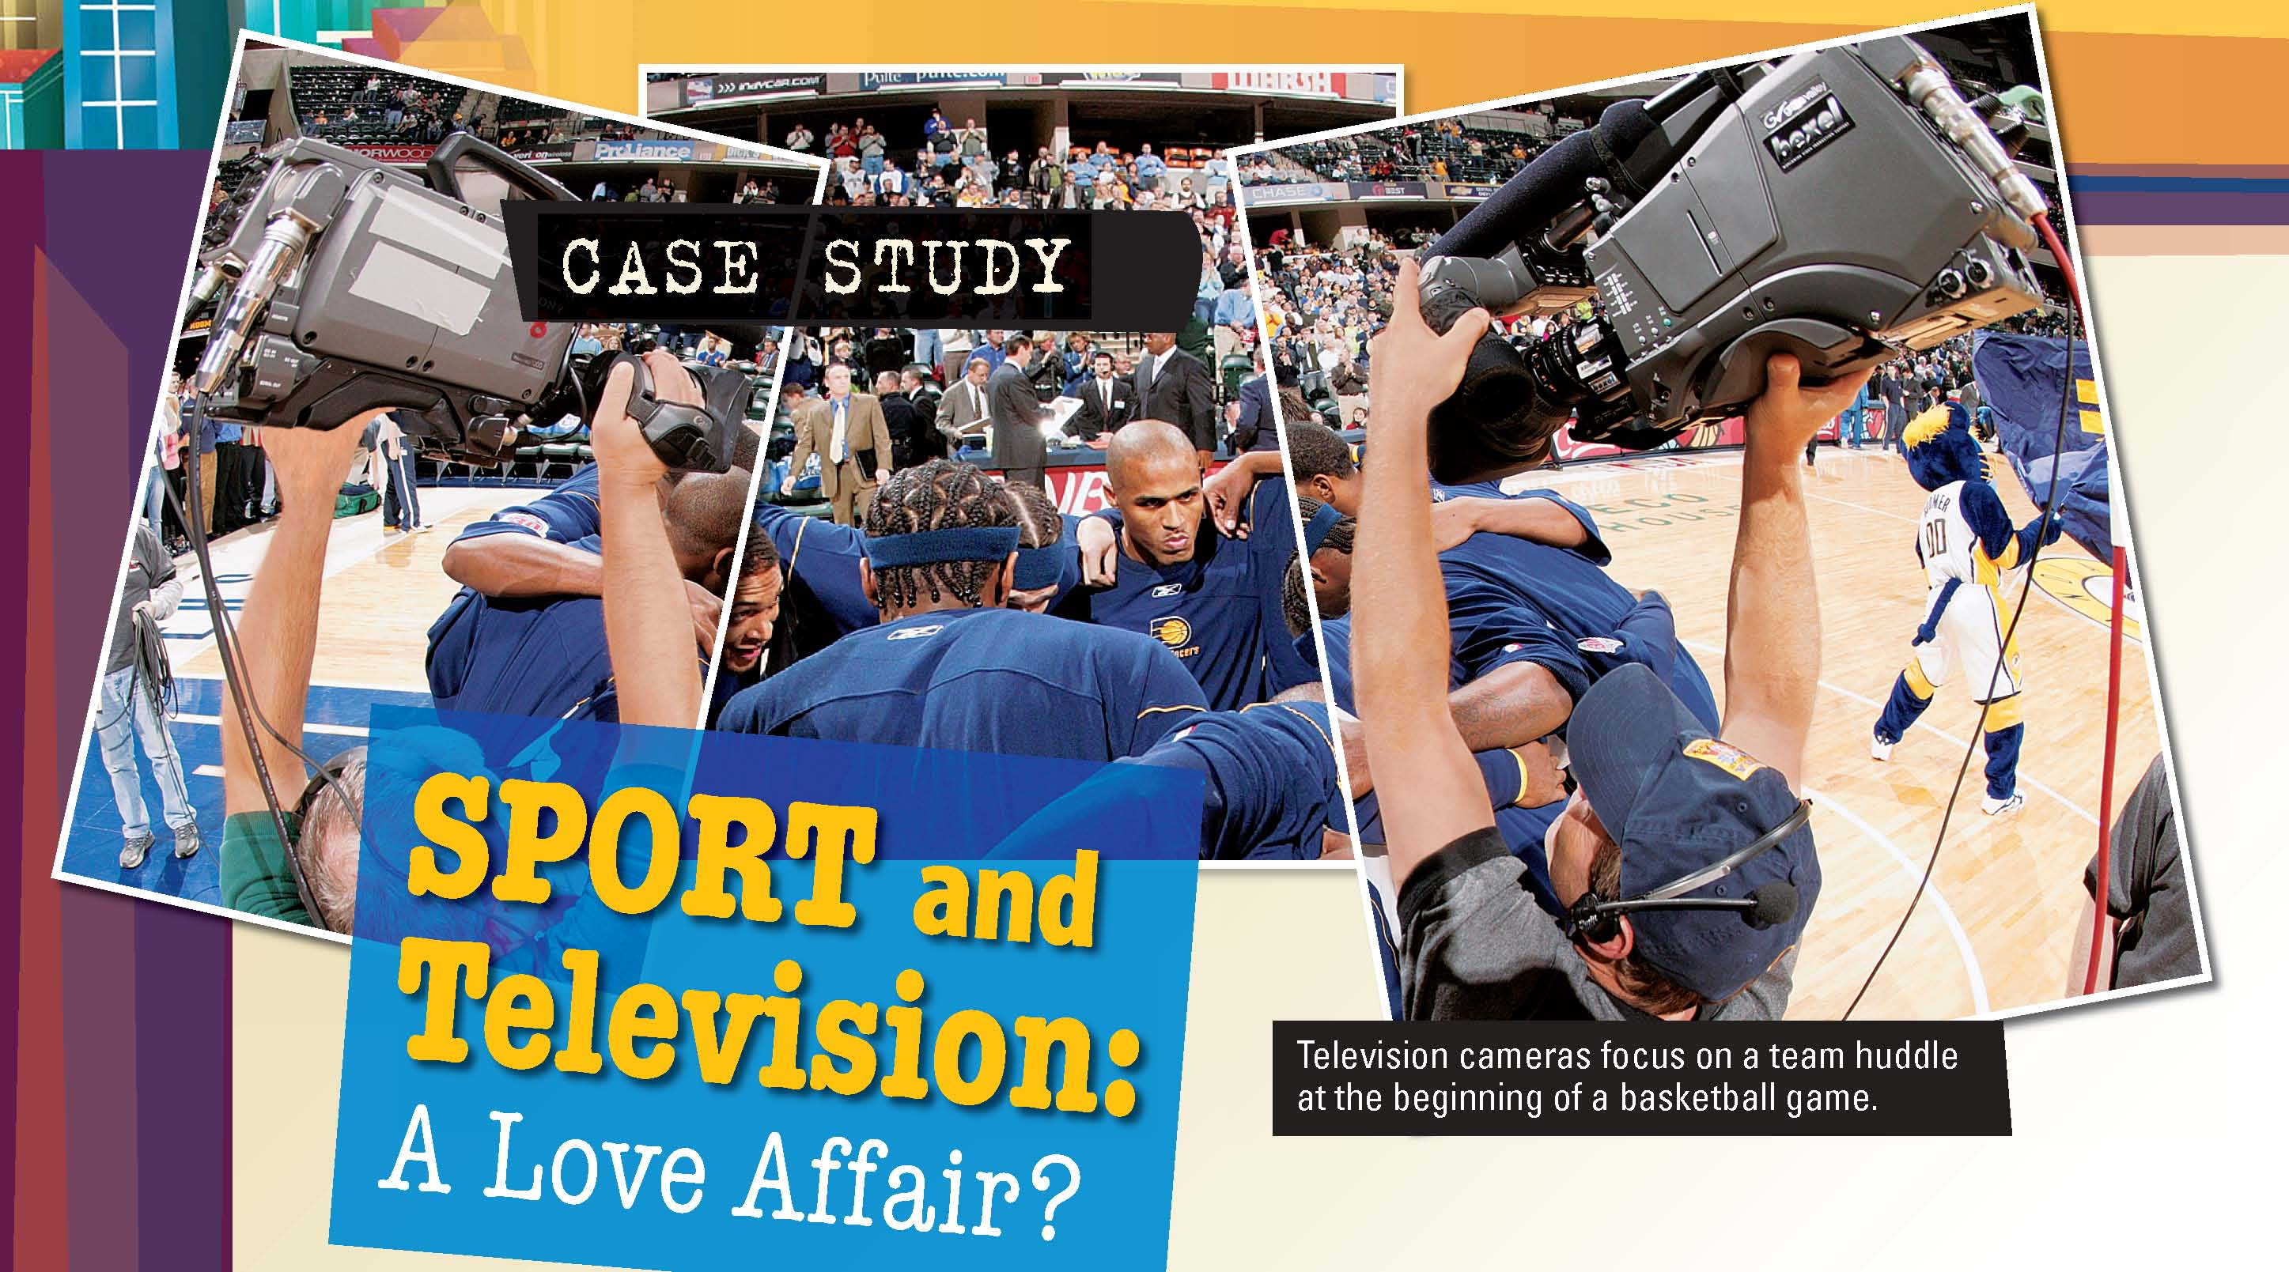

Slide 4
Section 1 at a Glance
Sport as a Social Institution
In sociological terms sport involves games that are won or lost on the basis of physical skills and are played according to specific rules.
Sport as a social institution is distinguished by characteristics such as secularization, equality, specialization, rationalization, bureaucratization, and quantification.

Slide 5
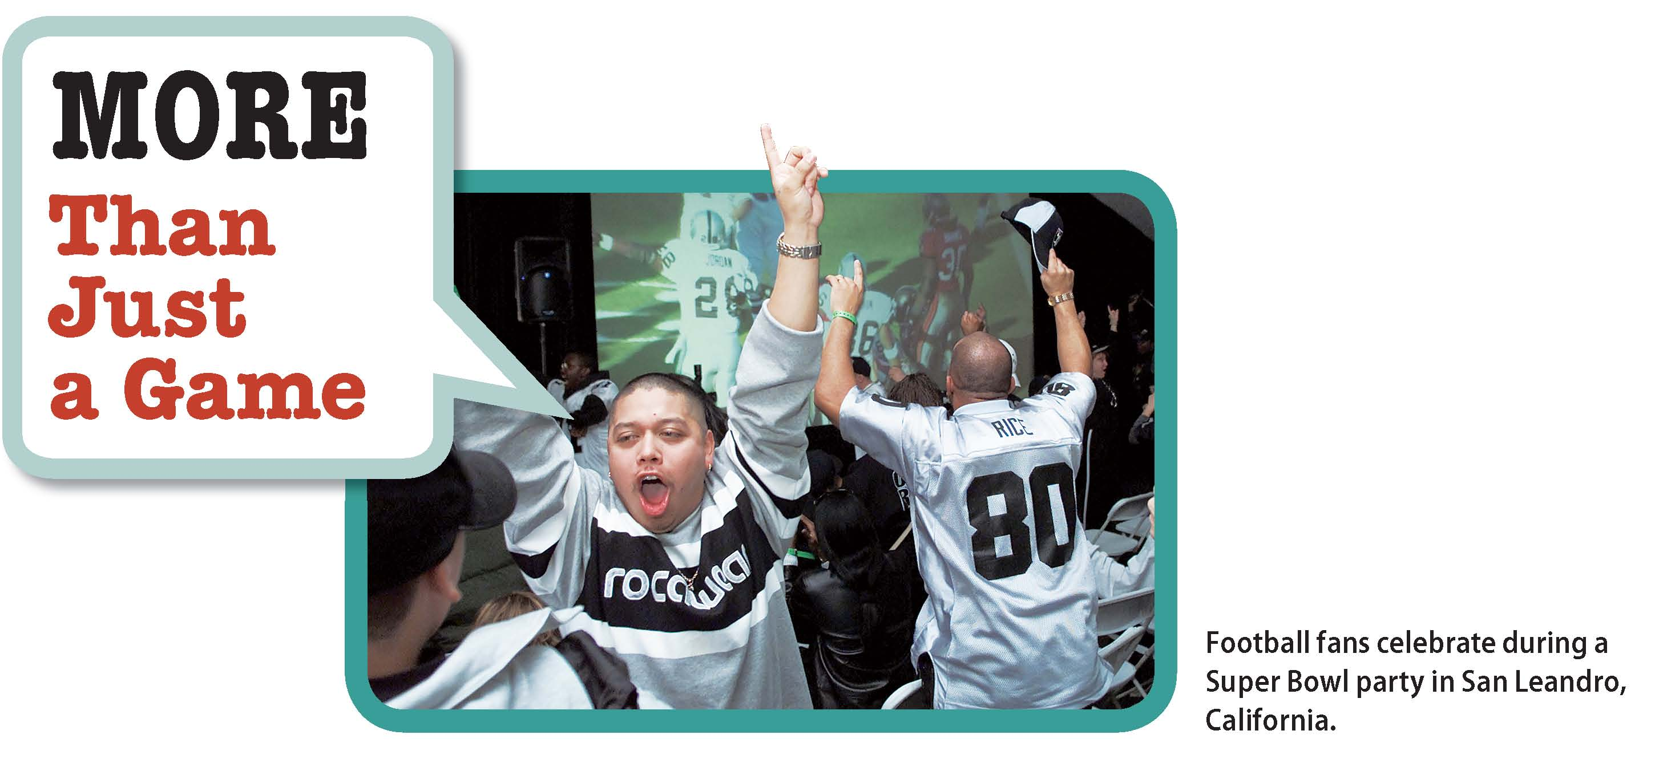
Why do some people consider Super Bowl Sunday a national holiday?

Slide 6
Defining Sport
Sport: competitive games that are won or lost on the basis of physical skills and played according to specific rules
For some sociologists, competition is the most important aspect.
Direct competition: Two or more individuals or teams compete against each other. (Examples: football, tennis, swimming)
Indirect competition: Athletes take turns at the same skill. (Examples: shot put, pole vault)
Competition against a standard: Individuals and/or teams compete against each other and against a preset standard. (Examples: figure skating, gymnastics)
Not all games that involve competition are sport. Dice and chess, for example, are not sport.
Childhood games (such as tag and leapfrog) are not sport. They are a form of play.

Slide 7
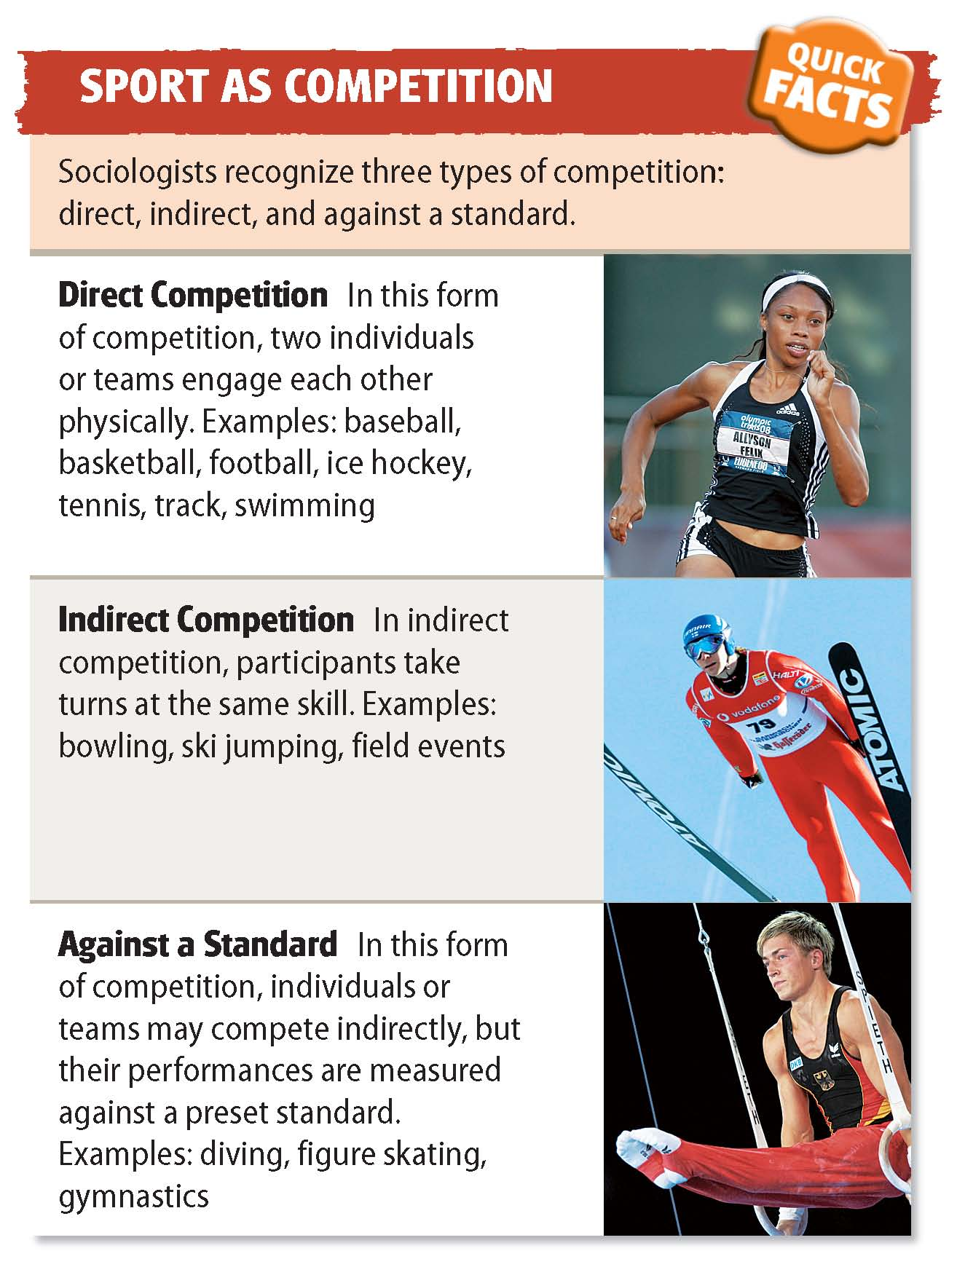

Slide 9
The Institutionalization of Sport
Physical games have been a part of human culture since the earliest times. Modern sport first emerged in England and followed the rise of industrialism. Guttmann claims that six characteristics define both sport and industrialism.
Secularization
Equality
In the past, many physical games were part of religious activities.
To become an institution in its own right, sport had to move from the realm of the sacred to that of the profane. This move is called secularization.
In the past only certain people were allowed to participate in physical games.
Two basic norms of modern sport are that competition is open to everyone and that the same rules apply to all contestants.
Notes:
–

Slide 10
The Institutionalization of Sport (cont.)
Specialization
Modern athletes specialize much more than athletes in the past.
Specialized aides such as coaches, trainers, managers, etc., also participate in sport.
Rationalization
The processes by which every feature of human behavior becomes subject to calculation, measurement, and control.
Sports are played with the same rules across the world.
Bureaucratization
Bureaucratization goes hand in hand with rationalization: with set rules, a formal organization must be charged with developing and enforcing those rules.
Quantification
Athletes want to know where they stand in relation to other athletes, both past and present.
The “win at any cost” mentality can lead to illegal drug use.

Slide 12
Section 2 at a Glance
Perspectives and Issues in American Sport
The three sociological perspectives differ in how they view sport’s impact on society. Functionalists concentrate on how sport helps to maintain stability in society. Conflict theorists are interested in the relationship between sport and social inequality. Interactionists focus on how sport influences everyday social behavior.
Sports sociologists focus on issues such as the role of race, the role of gender, and deviant behavior in sport.

Slide 13
Does violence serve a purpose in sport?

Slide 14
Sociological Perspectives on Sport
Sport is a huge part of life in the United States.
More than 120 million people attend professional sporting events each year.
With advent of sport stations on cable, fans can enjoy sports anytime they want.
Sociologists have various perspectives on sport’s role.
Functionalist Perspective
Sport helps maintain the stability of society by providing social integration, reinforcing social norms, provides athletes and spectators with socially acceptable aggression.

Slide 15
Sociological Perspectives on Sport
Conflict Perspective
Sport helps social inequality in society but can provide a distraction from people’s unhappiness. Some also believe that certain sports legitimate violence and make it more acceptable in society.
Interactionist Perspective
Sport influences society through its symbols, norms, and values. For example, it helps shape how people live by providing role models in the form of athletes. Coach-player relationships and being part of a sports team also affect how people live.

Slide 16
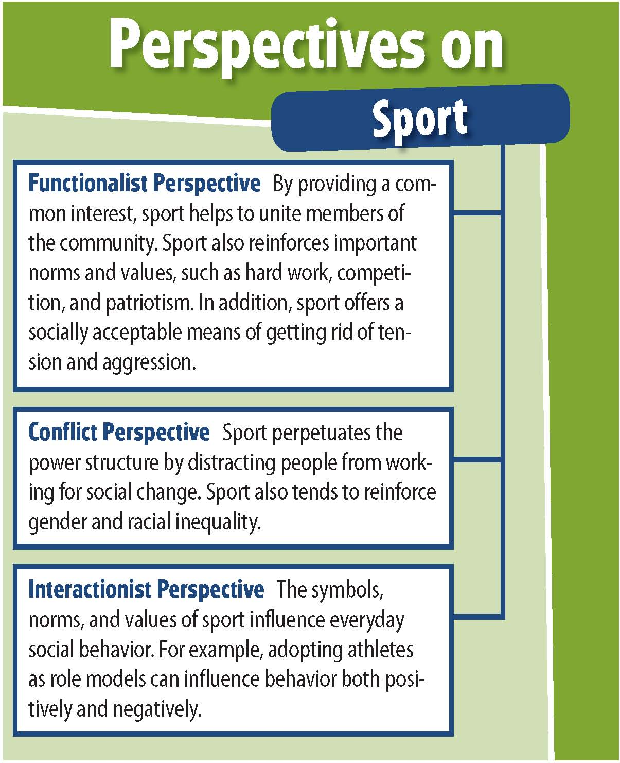

Slide 17
Issues in American Sport
Race and Sport
Studies tend to focus on examples of racial discrimination in sport.
Stacking: the practice of assigning people to central or noncentral athletic positions on the basis of race or ethnicity.
Stacking was common during the 1970s and 1980s, but less common now.
Some think coaches believe minority players did not have the decision-making skills needed for central positions.
Sociologists also wonder whether fans’ racial attitudes affect sport.

Slide 18
Issues in American Sport (cont.)
Women in Sport
Title IX of the Education Amendment Act of 1972 required equal funding for men’s and women’s sports.
Certain sports are considered more appropriate for women.
Deviance in Sport
Drug use is the most common deviant behavior among athletes. Many use substances to enhance performance.
Some sociologists consider the violence in sports as deviant, while others claim it is an expression of established cultural patterns.

Slide 20
Section 3 at a Glance
Mass Media as a Social Institution
The institutionalization of mass media has been driven by a series of intellectual and technological innovations, including writing and paper, the printing press, radio, television, and the computer.
Americans are able to obtain information from a wide variety of media. These media can be grouped into four categories: print, audio, visual, and online.

Slide 21
Can’t Live Without Them
How important is the media in your life?

Slide 22
The Institutionalization of Mass Media
Writing and Paper
With the development of agriculture, trade became more complex.
Writing made records of trades easier to remember and calculate.
Paper made writing more portable.
The Printing Press
Hand copying of books was a long, laborious, and costly process.
During the 1450s Gutenberg developed a movable-type printing press that made books, and hence the skill of reading, more common.

Slide 23
The Institutionalization of Mass Media
The Industrial Age
With industrialization, the forces of advertising, urbanization, and rising literacy led to the newspaper.
The development of electronic media such as movies, radio, and television brought entertainment into people’s homes.
The Information Society
The computer and the Internet revolutionized communication and information storage.
Information society: A community in which the exchange of information is the main social and economic activity

Slide 24
Click on the image to play the Interactive.

Slide 26
Mass Media in the United States
Americans obtain information from a wide variety of media. These media can be grouped into four categories, but some scholars claim this division is artificial.
Print Media
Audio Media
Newspapers, magazines, and books
Large but declining audience
48 percent read a newspaper daily; 85 percent read a magazine regularly; 25 percent read more than 10 books a year
Sound recordings (CDs, vinyl records, music videos and MP3s) and radio
Wide variety of radio formats: news, talk, classic rock, religion, etc.
99 percent have radio at home
Notes:
–

Slide 27
Mass Media in the United States
Americans obtain information from a wide variety of media. These media can be grouped into four categories, but some scholars claim this division is artificial.
Visual Media
Online Media
Movies, television, videocassettes, DVDs
Television reaches one of the largest audiences, with 98 percent having television at home
Internet services such as e-mail, online chat groups, social-networking sites, and online shopping
65 percent have Internet access at home
Notes:
–

Slide 28
Mass Media in the United States
Convergence
Media convergence: The idea that the media are merging and are no longer separate entities
Examples: newspapers available online, Internet radio, e-books
Media Consumption
On average, each American spends nearly 3,600 hours a year using media
Individual usage rates are affected by age, education, and income

Slide 29
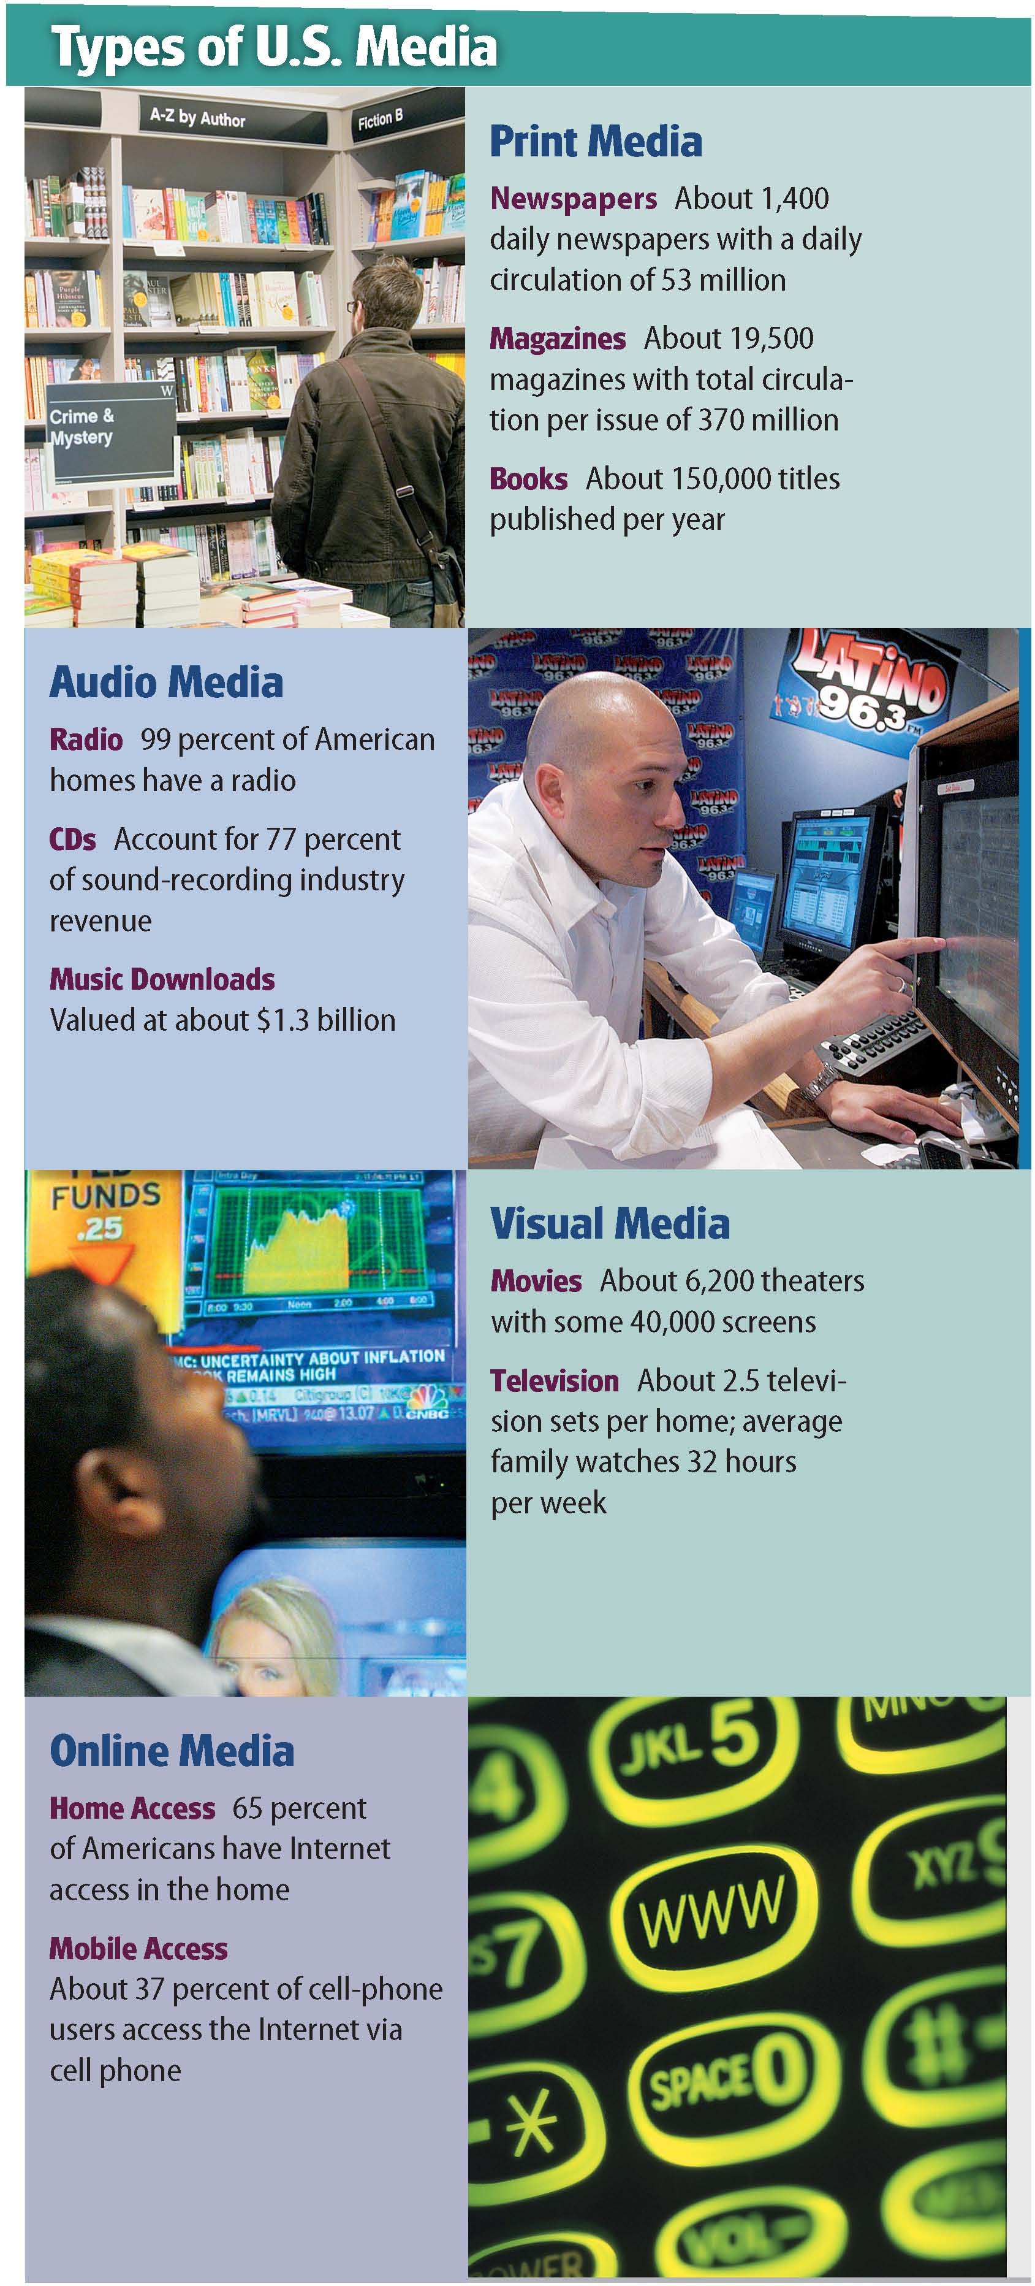

Slide 30
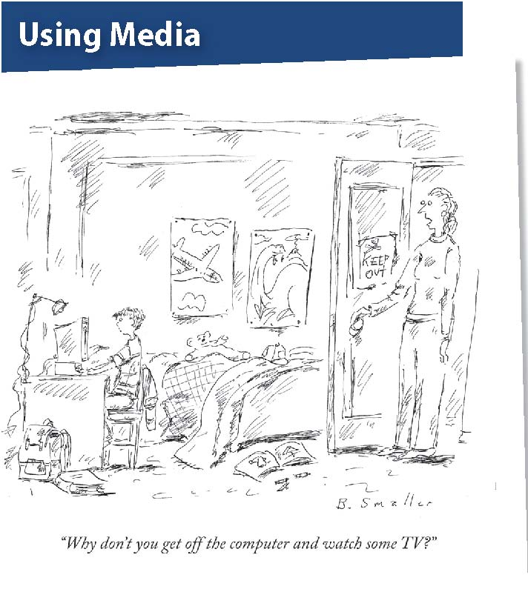

Slide 31
Section 4 at a Glance
Perspectives and Issues in Mass Media
The three sociological perspectives differ in the way they view mass media. Functionalists focus on the ways mass media help to preserve social stability. Conflict theorists focus on how mass media reinforce the existing social order. Interactionists look at the impact of mass media on social interaction.
Sociologists are interested in the power of the media and how mass media affects children and civic and social life.

Slide 32
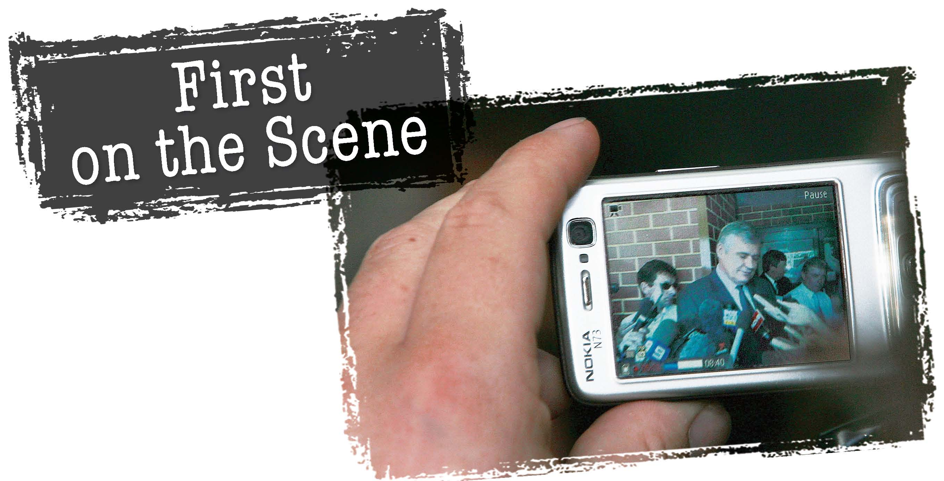
Can anyone report the news?

Slide 33
Sociological Perspectives on Mass Media
Functionalist Perspective
Media keep track of what is happening, interpret information, transmit cultural values, and entertain people. These functions support the stability and smooth operation of society.
People need to know what is going on around them to be productive in society.
Media can consciously or inadvertently help pass on society’s basic values and beliefs.

Slide 34
Sociological Perspectives on Mass Media
Conflict Perspective
Media convinces people to accept the existing power structure.
Knowledge-gap hypothesis: the wealthy and better-educated acquire new information more quickly, creating a divide
Digital divide: gap between those with access to new technology and others
Representation of certain groups in the media might reinforce social inequality.

Slide 35
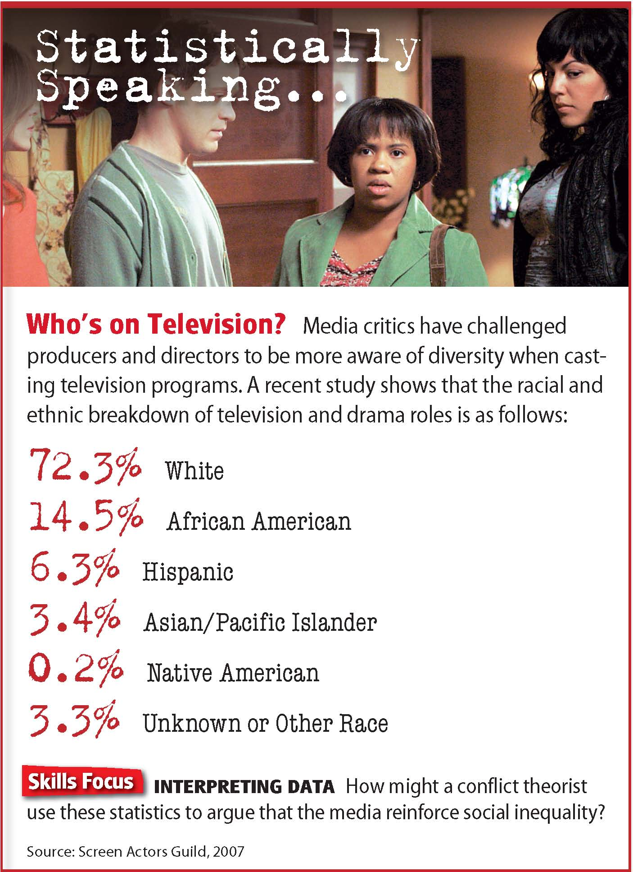

Slide 36
Sociological Perspectives on Mass Media
Interactionist Perspective
Mass media shape everyday social interactions. Many people plan events around media.
Some consider gatherings to watch television and the like to be social events. Others think watching television is essentially a solitary event.
Some see the Internet as a new method of social interaction, while others view the Internet as a threat to social interaction.

Slide 37
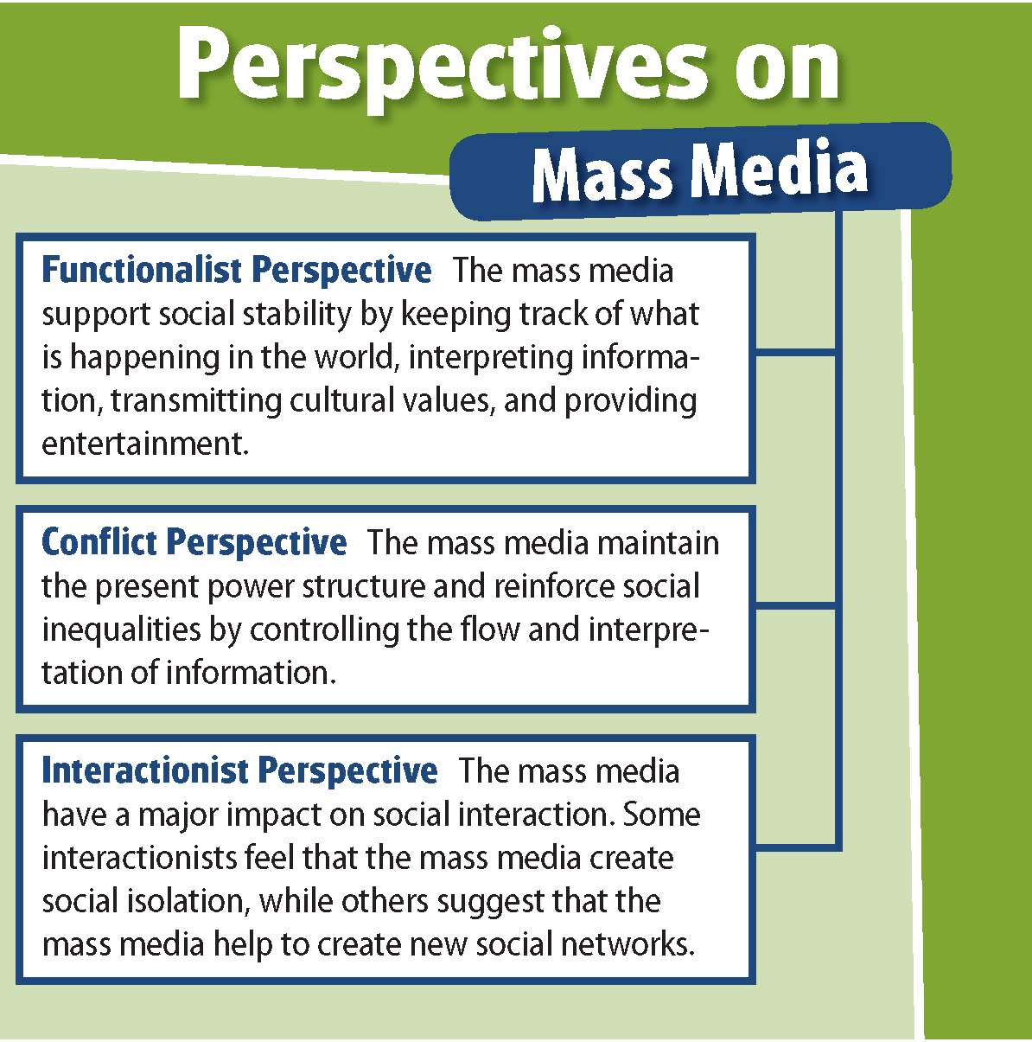

Slide 38
Contemporary Mass-Media Issues
Mass Media and Children
Watching television is the primary after-school activity for most students.
Many worry that seeing violence on television encourages actual violence.
Links have been found between large amounts of television viewing and low test scores.
Children are targeted by advertisers.

Slide 40
Contemporary Mass-Media Issues
Mass Media and Civic and Social Life
Some argue that people have become less socially active as television has become more common.
Social capital: Everything that makes up a community
The Internet may also lead to withdrawal from community life, although some argue that online communities are taking the place of face-to-face interaction.

Slide 41
Contemporary Mass-Media Issues
The Power of the Media
Many feel that the new media wield too much power.
Spiral of silence: As news media offer repeated opinions, more people accept these opinions, and people who disagree are less likely to voice their views.
Agenda setting: The media do not tell people what to think, but what to think about.
Gatekeepers: Media figures decide what the agenda is in a particular story.
Opinion leaders: Respected individuals are the first to evaluate messages and their importance.

Slide 43
Sociology in Today’s World
Video Games and Violence
A series of school shootings in the 1990s led many to believe real-life violence was encouraged by violence encountered in video games and on television.
First-person shooter game players use an assortment of weapons to fight off enemies.
Newspapers put blame of school shootings on these games.
Sociologist Karen Sternheimer began a study to test the link between games and violence.
Sternheimer’s study found no correlation between video games and the rate of violence among teens.
Studies that seem to support the correlation do not take into account important factors such as poverty, neighborhood stability, or family relationships, according to Sternheimer.
Notes:
–

Slide 44
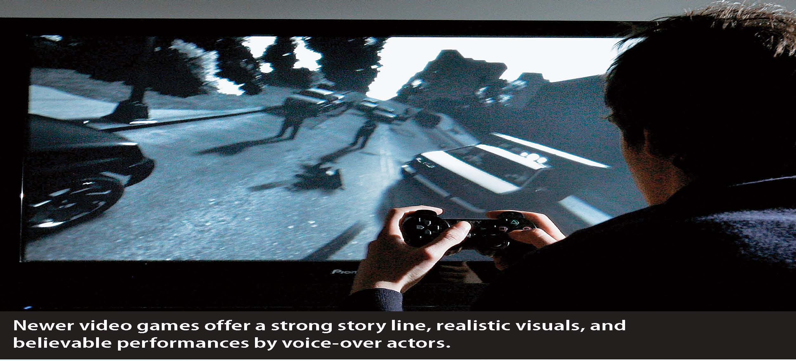

Slide 45
Sociology in Today’s World
Thinking Critically
What weaknesses did Karen Sternheimer find in the studies of the impact of video games?
Do you think there is any connection between violent video games and aggressive behavior? Why or why not?

Slide 46
Lab: Applying What You’ve Learned
Promoting a Class on Sport and Mass Media
What is the best way to encourage students to learn more about social institutions such as sport and mass media?
1. Introduction
2. Sharing Your Expertise
In this lab, you will create a poster to promote a class on sport and mass media.
Working in groups, you will become an expert in one area and contribute your expertise to the design of your poster.
In your second group, provide the following information: your topic, important terms and concepts, how your topic is important, and specific examples.
Notes:
–

Slide 47
Lab (cont.)
3. Making the Poster
After each member has shared his or her expertise, design a poster that includes:
three to five sentences with key ideas.
two terms related to the topic.
an example.
a reason students would find the class useful or interesting.
an illustration that enhances understanding.
4. Exchanging Posters
Exchange posters with another group.
Review the poster your group has received and make note of information that you did not include in your own poster.
Notice the examples and illustrations that the other group used on their poster.

Slide 48
Lab (cont.)
5. Discussion
What did you learn from this lab? As a group, discuss the following:
How successful was the class at making posters?
Which topics were easiest to understand? Most difficult?
Which examples and illustrations were most helpful?
How do you think technology will change sport and mass media in your lifetime?

Slide 49
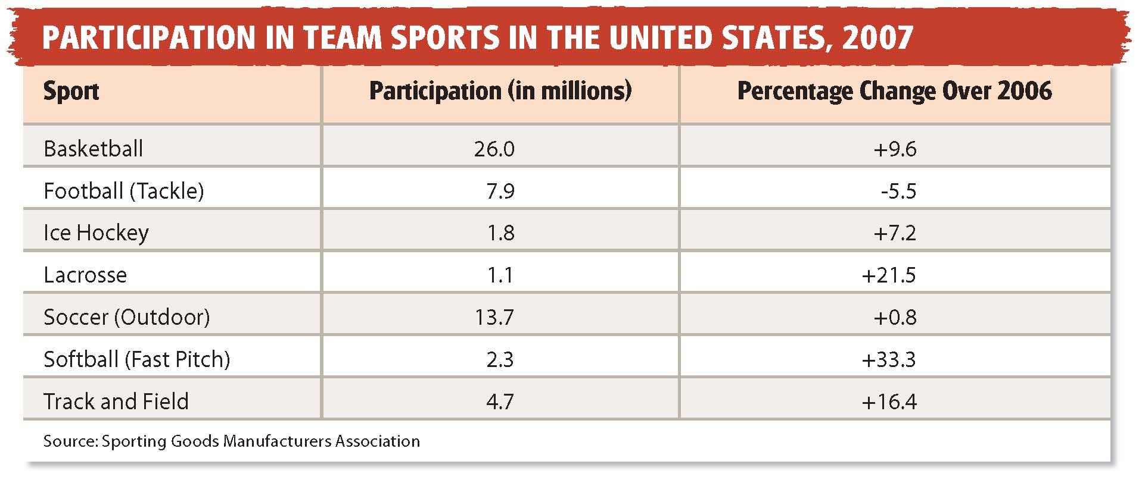
Lab (cont.)

