Slide 1
Chapter 16: Collective Behavior and Social Change
Case Study: Why Social Movements Matter
Section 1: Collective Behavior
Section 2: Social Movements
Section 3: Social Change
Section 4: Theories of Social Change
Section 5: Modernization
Simulation: Applying What You’ve Learned

Slide 2
Case Study: Why Social Movements Matter
Social movements “crest and wane” while experiencing both successes and failures. The civil rights movement in the United States is one example. In the 1950s and 1960s, African Americans and anti-segregationists fought for equal treatment and urged Congress to pass new legal protections for minorities. While these efforts resulted in dramatic changes, African Americans still experienced discrimination in several areas.

Slide 3
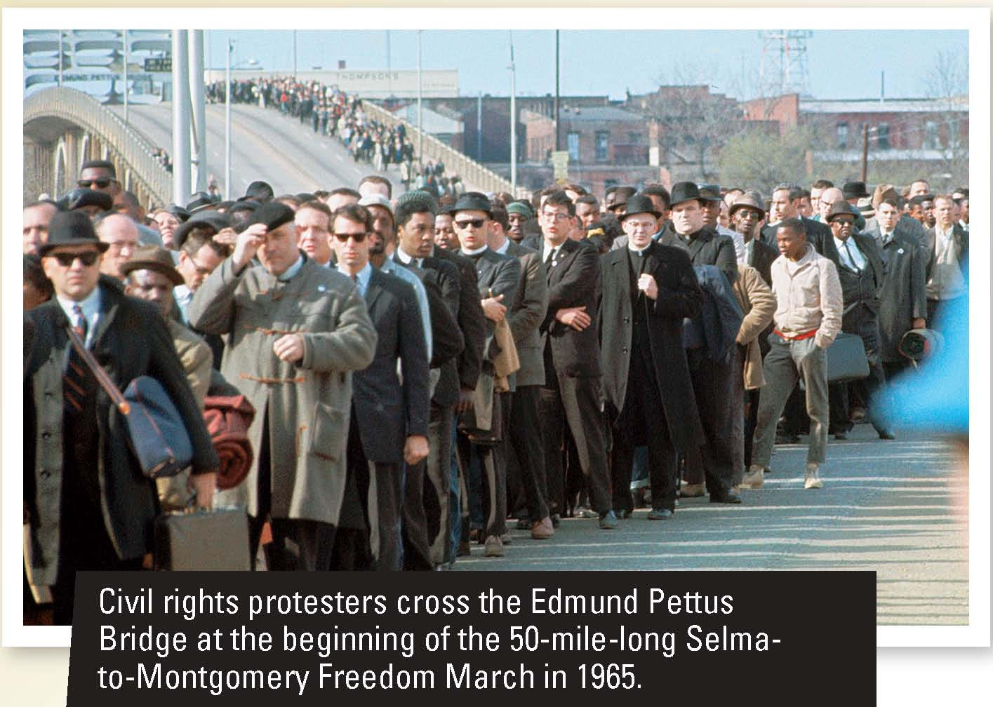
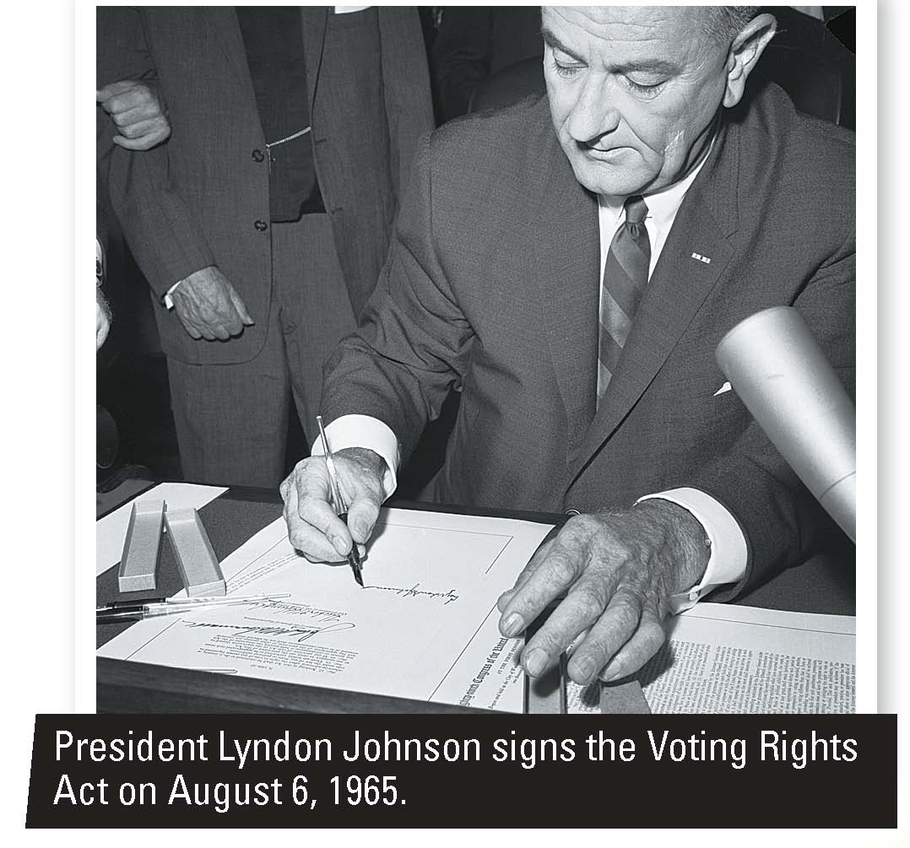

Slide 4
Section 1 at a Glance
Collective Behavior
Collective behavior is the relatively spontaneous social behavior that occurs when people try to develop common solutions to unclear situations. It can be divided into three broad categories: crowds, collective preoccupations, and public opinion.
Explanations offered for collective behavior include contagion theory, emergent-norm theory, and value-added theory.

Slide 5
Collective Behavior
Main Idea
Collective behavior is divided into three broad categories: crowds, collective preoccupations, and public opinion. Sociologists offer three explanations for collective behavior: contagion theory, emergent-norm theory, and value-added theory.
Reading Focus
How do sociologists define collective behavior?
What kinds of collective behavior do crowds exhibit?
What do collective preoccupations involve?
How do politicians, businesses, and interest groups try to influence public opinion?
What theories have been offered to explain collective behavior?

Slide 6
Flash Mob!
What in the world is going on?

Slide 7
Defining Collective Behavior
The relatively spontaneous social behavior that occurs when people try to develop common solutions to unclear situations
Difficult to study because
the types of collective behavior are numerous.
behavior involves many people who do not know each other.
collective behavior is not an enduring aspect of society.
Collectivities are groups that exhibit collective behavior
Collectivities include crowds, mobs, riots, panics, mass hysteria, crazes, fashions, fads, rumors, urban legends, and public opinion.

Slide 8
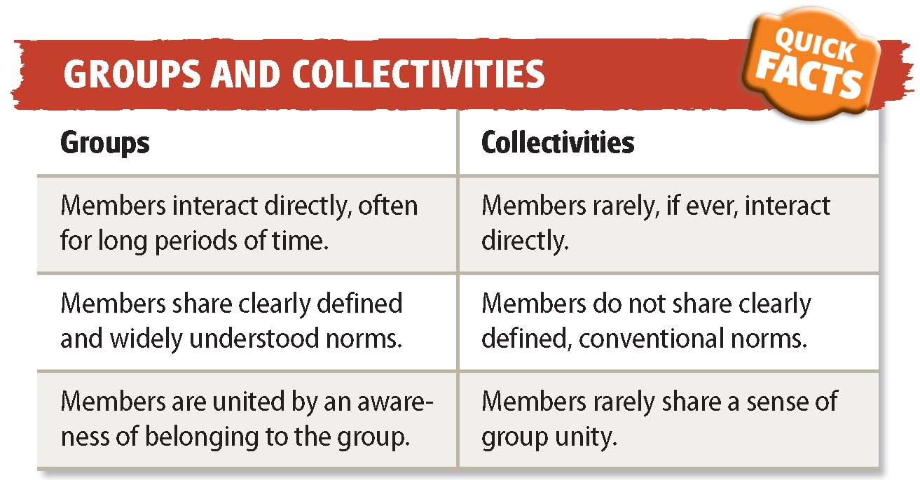

Slide 9
Reading Check
Contrast
How do collectivities differ from groups?
Answer: In contrast to social groups, individuals in collectivities have limited interaction with one another, do not share defined or conventional norms, and do not share a sense of group unity.

Slide 10
Crowds
Types of Crowds
A crowd is a temporary gathering of people who are in close enough proximity to interact.
Types of crowds include the following:
Casual crowd: forms spontaneously because some event captures people’s attention; least organized and most temporary type of crowd (Example: people waiting in line to buy movie tickets)
Conventional crowd: more structured; not much interaction, but people act according to a set of rules (Example: people gathered for a public lecture)

Slide 11
Crowds
Types of crowds (cont.):
Expressive crowd: has no apparent goal or purpose; forms around emotionally charged events (Example: audiences at rock concerts)
Acting crowd: a violent group of people formed because of hostile and destructive emotions (Example: looters after a natural disaster)
Protest crowd: exhibit characteristics of acting crowds; better organized and longer lasting (Example: people protesting a political convention)

Slide 14
Crowds
Mobs and Riots
Mobs
Emotionally charged collectivities whose members are united by a specific destructive or violent goal
Usually have leaders who urge the group towards common action
Riots
Collections of people who erupt into destructive behavior
Less unified than mobs

Slide 15
Crowds
Panics
Spontaneous and uncoordinated group actions to escape some perceived threat
Mutual cooperation breaks down
Often occur in situations outside the realm of everyday experience
Mass Hysteria
Unfounded anxiety shared by people who can be scattered over a wide geographic area
Involves irrational beliefs
Usually short lived

Slide 16
Reading Check
Identify Cause and Effect
What types of collective behavior result from violence and fear?
Answer: mob, panic, and mass hysteria

Slide 17
Collective Preoccupations
Even people who rarely meet, let alone interact, engage in similar behavior and share an understanding of the meaning of that behavior. Examples are fashions, fads, rumors, and urban legends.
Fashions and Fads
Rumors and Urban Legends
Fashions: attachments to particular styles of appearance or behavior
Fads: unconventional objects, actions, or ideas that a large number of people are attached to for a short period of time
Rumors: unverified pieces of information that are spread from one person to another
Urban legends: stories that teach a lesson and seem realistic but are untrue
Notes:
–

Slide 18
Reading Check
Find the Main Idea
What are collective preoccupations
and how do they spread?
Answer: Collective preoccupations involve people who rarely meet, yet engage in similar behavior through participating in similar fads or fashion, or taking part in the spread of the same rumor or urban legend.

Slide 19
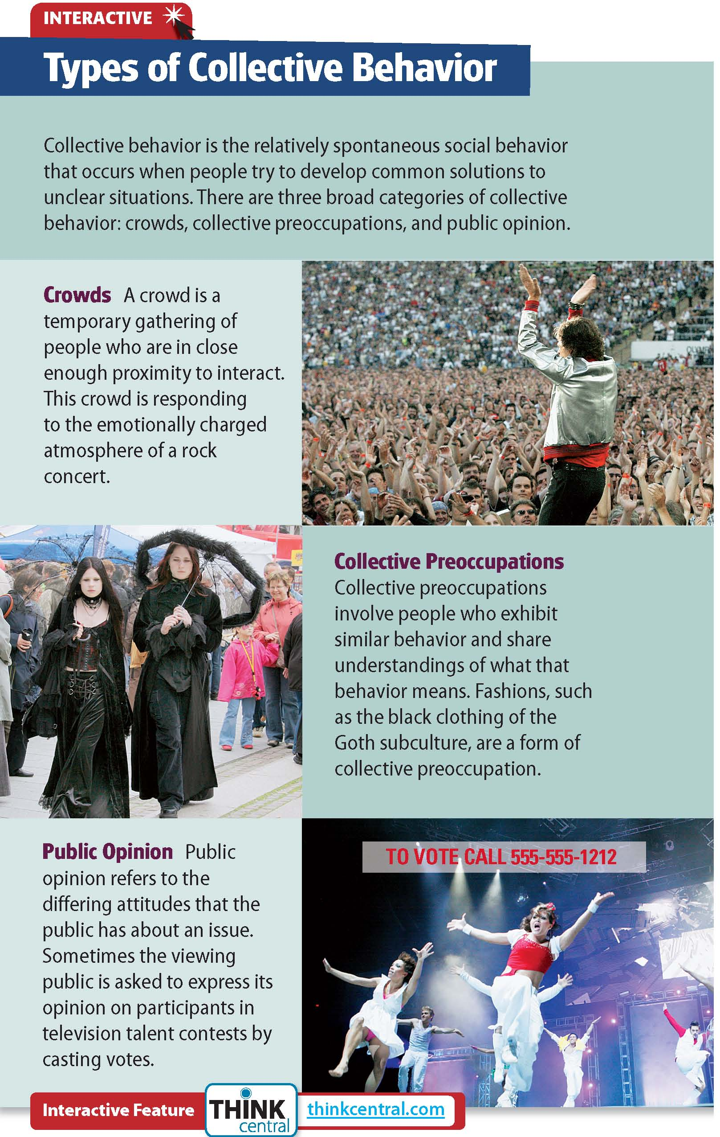
Click on the image to play the Interactive.

Slide 20
Public Opinion
Public opinion is the collection of differing attitudes that members of a public have about a particular issue.
Subject to rapid change
People seeking elected office pay much attention to public opinion.

Slide 21
Public Opinion
Politicians, interest groups, and businesses pay billions of dollars to influence the public using seven types of propaganda or advertising:
Testimonials
Transfer
Bandwagon
Name-calling
Plain-folks
Glittering generalities
Card stacking

Slide 22
Reading Check
Identify Supporting Details
What techniques are used to sway public opinion?
Answer: testimonials, transfer technique, bandwagons, name-calling, plain-folks, glittering generalities, and card stacking

Slide 24
Explaining Collective Behavior
Contagion Theory
The hypnotic power of a crowd encourages people to give up their individuality to the stronger pull of the group.
A crowd offers anonymity, overtakes members with emotions, and makes members suggestible.
Emergent-Norm Theory
People are often faced with a situation in which traditional norms of behavior do not apply.
As a result, new norms gradually emerge.

Slide 25
Explaining Collective Behavior
Value-Added Theory
Identified steps taken that result in collective behavior
Six conditions result in collective behavior: structural conduciveness, structural strain, growth and spread of a generalized belief, precipitating factors, mobilization for action, and social control.

Slide 26
Reading Check
Contrast
How do the three theories differ in how they explain collective behavior?
Answer: contagion theory—the hypnotic power of a crowd encourages people to bend to the collective mind of the crowd; emergent-norm theory—when faced with no clear standards for behavior, people in a crowd conform to a new set of norms; value-added theory—collective behavior develops and narrows as each “value” is added to it.

Slide 27
Current Research in Sociology
Responding to Terrorism
Although deeply shocked by the terrorist attacks on September 11, 2001, Americans quickly came together in a collective response. Since the attacks, however, opinions on the appropriate reaction to terrorists have shifted.
Early Response
Initial response was shock and anger.
Feelings of anxiety for own safety increased.
Many felt a sense of unity.
Most supported military action against Afghanistan.
Later Response
Many supported the war in Iraq at first.
As the war continued, it lost support.
Half saw war as a stalemate.
Many stated the nation was not prepared to prevent another attack.
Notes:
–

Slide 29
Current Research in Sociology
Thinking Critically
How have American attitudes on the war on terror changed?
Do you think changes in the United States since 9/11 have been positive? Why or why not?

Slide 30
Section 2 at a Glance
Social Movements
A social movement is a long-term conscious effort to promote or prevent social change. Sociologists have identified four stages in the life cycle of social movements: agitation, legitimation, bureaucratization, and institutionalization.
Explanations for the development of social movements include relative deprivation theory and resource-mobilization theory.

Slide 31
Social Movements
Main Idea
A social movement is a long-term conscious effort to promote or prevent social change. Sociologists have identified four stages in the life cycle of social movements: agitation, legitimation, bureaucratization, and institutionalization.
Reading Focus
What types of social movements exist, and how do they differ?
What are the stages of the life cycle of social movements?
How do sociologists explain the existence of social movements?

Slide 32
How do social movements arise and flourish?

Slide 33
Types of Social Movements
Social change: Alterations in various aspects of society over time
Social movements: Long-term conscious effort to promote or prevent social change
Long-lasting
Highly structured organization with formally recognized leaders
Deliberate attempt to institute or block societal change
Can attract memberships in the millions
Four types based on the level of change sought

Slide 34
Types of Social Movements
Reactionary Movements
Goal is to reverse current social trends.
Members are suspicious of and hostile toward social change.
Often violent
Conservative Movements
Goal is to protect what they see as society’s prevailing values from changes that they consider to be a threat to those values.
Revisionary Movements
Goal is to improve, or revise, some part of society through social change.
Use legal channels, and focus on a single issue
Revolutionary Movements
Goal is a total and radical change of the existing social structure.
Use violent or illegal actions, and can result in drastic change

Slide 35
Reading Check
Contrast
How do the four types of social movements differ in terms of the level of social change they seek?
Answer: reactionary—to reverse current social trends; conservative—to protect what is seen as society’s prevailing values from change; revisionary—improve or change part of society; revolutionary—to cause total and radical change to the existing social structure

Slide 36
Life Cycle of Social Movements
Agitation
Emerge out of the belief that a problem exists and that solutions need to be found
Begins with a small group with a strong commitment, sometimes seen as cranks
Legitimation
As movement finds support, it becomes more respectable.
Leaders are seen as spokespeople of a just cause.
At this stage, media give attention.
Bureaucratization
Occurs as the organizational structure of the movement becomes more formal
Has ranked structure, official policies, and strategies for future
Original goals are sometimes lost
Institutionalization
Final stage—occurs when movement has become an established part of society
Movement resists proposals for change, and membership dwindles

Slide 38
Reading Check
Sequence
What are the stages in the life cycle of social movements?
Answer: agitation, legitimation, bureaucratization, institutionalization

Slide 39
Explaining Social Movements
Early theories labeled social movements as the product of psychologically disturbed people. Sociologists, however, see problems in the social structure as the cause.
Relative Deprivation Theory
Resource-Mobilization Theory
Suggests movements arise when a group of people feel economically or socially deprived compared to what other groups have.
People seek things that others have and that they do not.
The organization and effective use of resources results in the acceptance of the group’s goal.
Need supporters, resources, and access to media.
Some sociologists say both theories are accurate descriptions.
Notes:
–

Slide 40
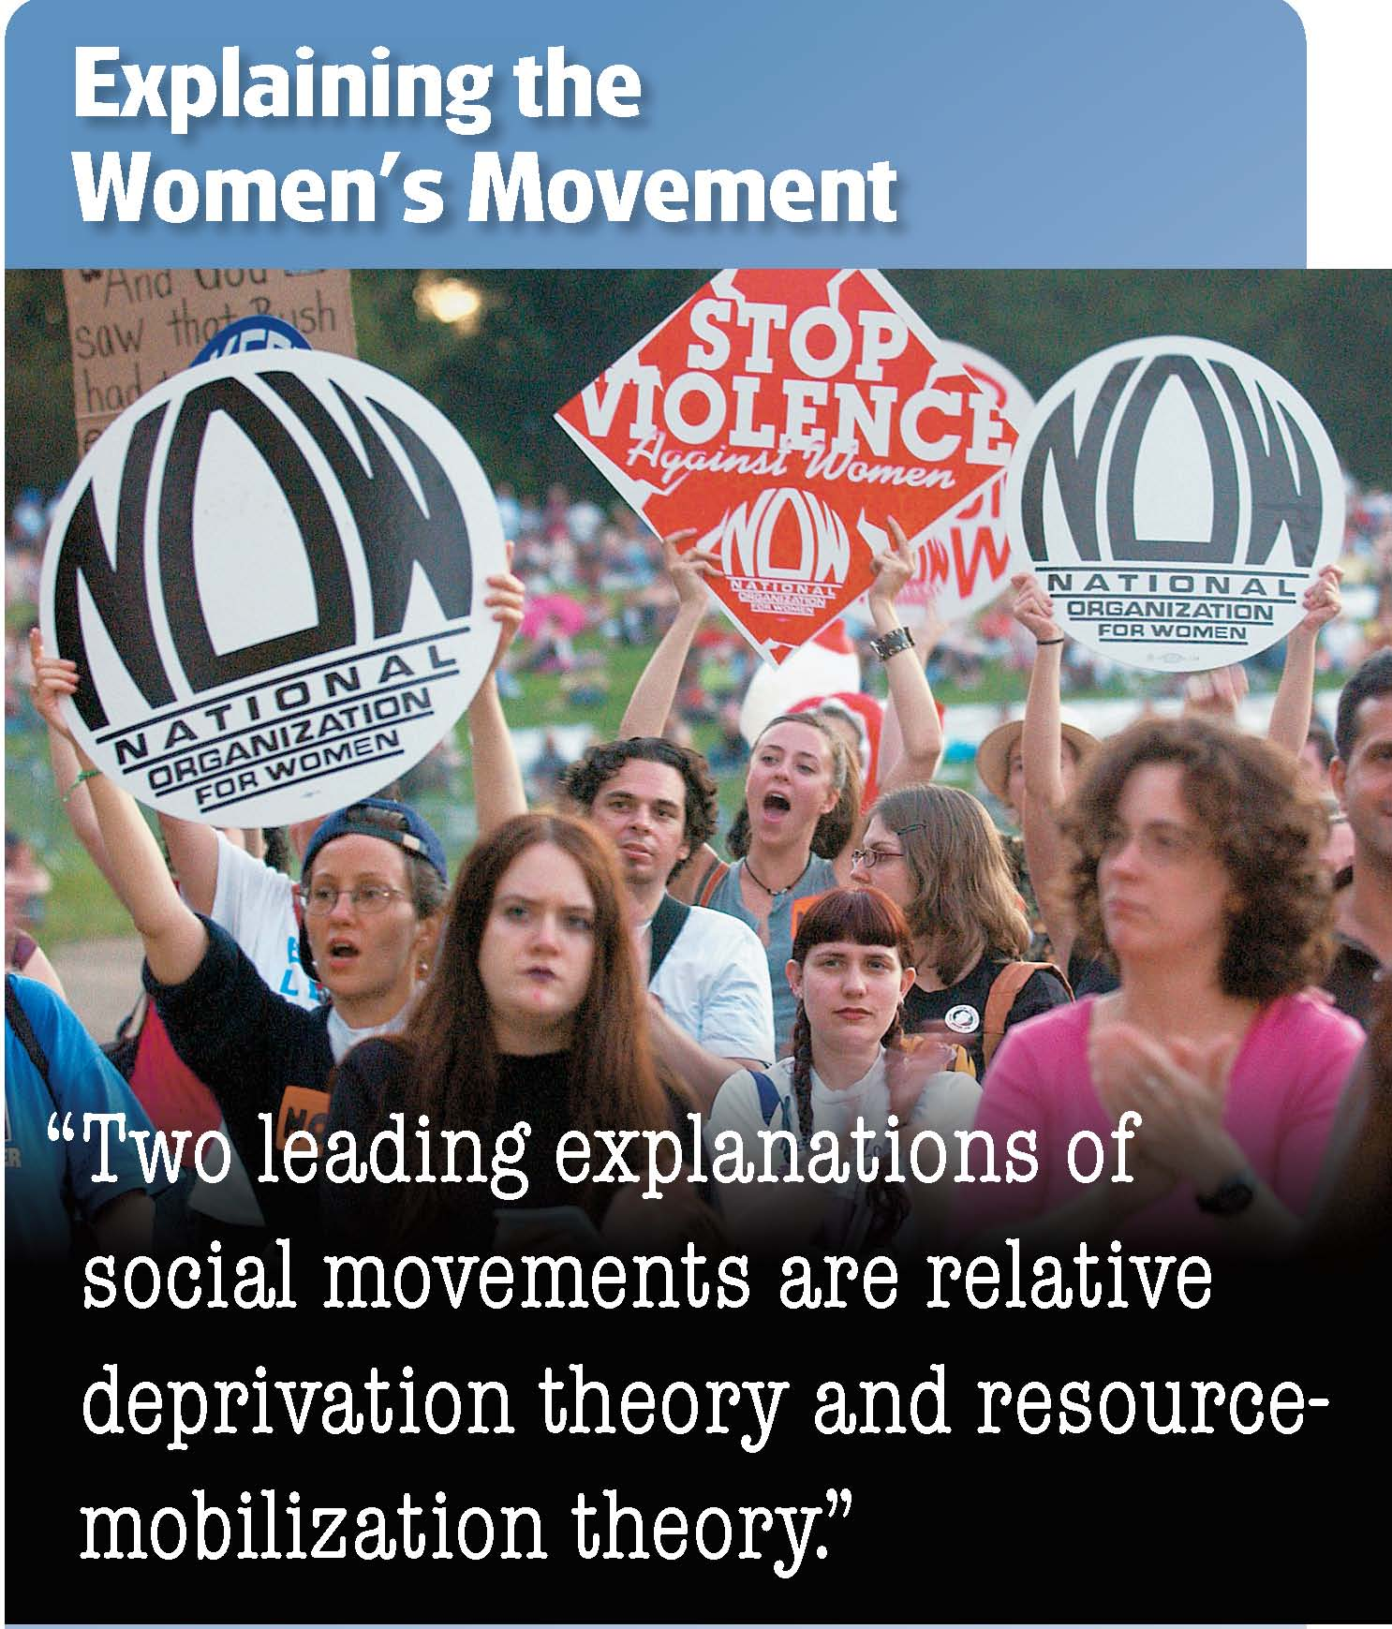

Slide 41
Reading Check
Summarize
What are the two major sociological theories on the development of social movements?
Answer: relative deprivation theory—social movements arise when large numbers of people feel economically or socially deprived; resource-mobilization theory—resources, including a body of supporters, financial resources, and access to the media, are necessary for a successful social movement

Slide 42
Section 3 at a Glance
Social Change
The major factors that stimulate social change are values and beliefs, technology, diffusion, population, the physical environment, and wars and conquests.
Ethnocentrism, cultural lag, and vested interests all create resistance to social change.

Slide 43
Social Change
Main Idea
The major factors that stimulate social change are values and beliefs, technology, diffusion, population, the physical environment, and wars and conquests. Ethnocentrism, cultural lag, and vested interests all create resistance to social change.
Reading Focus
What are the main sources of social change?
Why is there resistance to social change?

Slide 44
How do changes in values affect day-to-day life?

Slide 45
Sources of Social Change
Values and Beliefs
Ideology: A system of beliefs or ideas that justifies the social, moral, religious, political, or economic interests held by a group or by society
Often spread through social movements; can have far-reaching effects
Technology
The knowledge and tools that people use to adjust and adapt their environment
Arise through discovery and invention

Slide 46
Sources of Social Change
Diffusion
Sharing and spread of cultural traits from one society to another
Reformulation: The process of adapting borrowed cultural traits
Population
A change in size or composition of a population can cause changes in a culture.
Size can affect economy.
Different cultures brought together through migration.

Slide 47
Sources of Social Change
The Physical Environment
Origin of food supplies, natural disasters, and changes in the supply or demand of a natural resource can change the culture of the groups that are affected.
Wars and Conquests
Not as common as other sources, but more dramatic changes
War often results in technological and medical advances

Slide 49
Reading Check
Summarize
What are the six major factors that cause social change?
Answer: values and beliefs, technology, diffusion, population, the physical environment, and wars and conquests

Slide 50
Resistance to Social Change
Resistance
Rarely occurs without opposition
Many who oppose change come to accept it.
Some remain opposed but learn to adapt.
Ethnocentrism
People often believe that their own ideas and ways of doing things are best and strongly resist changes from outside their culture.
Cultural Lag
Material culture changes quickly, while nonmaterial culture lags behind and changes more slowly.
New laws and customs must be formed to address new technology.
Vested Interests
People who benefit from the status quo usually resist change.
Some people feel that the known problems of today are better than unknown problems that come with change.

Slide 51
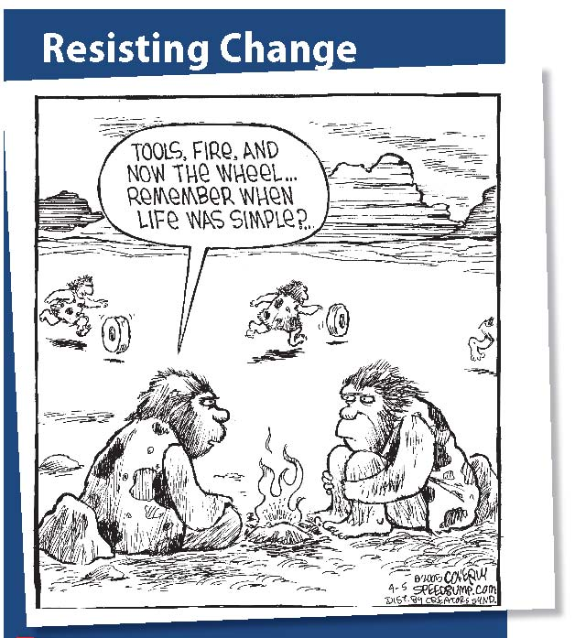

Slide 52
Reading Check
Find the Main Idea
What forms does resistance to social change take?
Answer: ethnocentrism—the idea that the beliefs of one’s own society are superior to the beliefs of other societies; cultural lag—the fact that material cultures change faster than nonmaterial cultures; vested interests—the fact that many in society prefer that social changes not occur

Slide 53
Sociology in Today’s World
Globalization and Social Change
One of the most powerful forces influencing life today is globalization, the process by which societies around the world become increasingly interconnected and interdependent.
Economic Globalization
Multinational corporations operate offices and factories across the world.
Exchange of products among nations is increasing.
Globalization and Transportation
Multinational companies need to transport people and goods across the globe.
New forms of transportation have been created.
Notes:
–

Slide 54
Sociology in Today’s World
Globalization and Social Change
One of the most powerful forces influencing life today is globalization, the process by which societies around the world become increasingly interconnected and interdependent.
Tourism
As transportation routes improve, tourism becomes more common and less expensive.
Face-to-face interactions among a variety of people can occur.
Diversity in America
Globalization has led the American people to be much more diverse.
Notes:
–

Slide 55
Sociology in Today’s World
Thinking Critically
How does globalization contribute to social change?
How has globalization affected your community? What changes has globalization brought to your life?

Slide 57
Section 4 at a Glance
Theories of Social Change
The functionalist perspective offers three explanations of social change. Cyclical theory suggests that societies arise, go through various stages of development, then decline. Evolutionary theory holds that societies develop toward increasing complexity. Equilibrium theory holds that change occurs in an effort to maintain social stability.
From the conflict perspective, change is the result of conflict inherent in society.

Slide 58
Theories of Social Change
Main Idea
Sociologists have developed theories to describe how and why social change occurs. Functionalist theories suggest that change takes place to maintain balances in the social order. Conflict theory focuses on conflict among groups as a source of change.
Reading Focus
What functionalist theories have been offered to explain social change?
How does conflict theory explain social change?

Slide 59
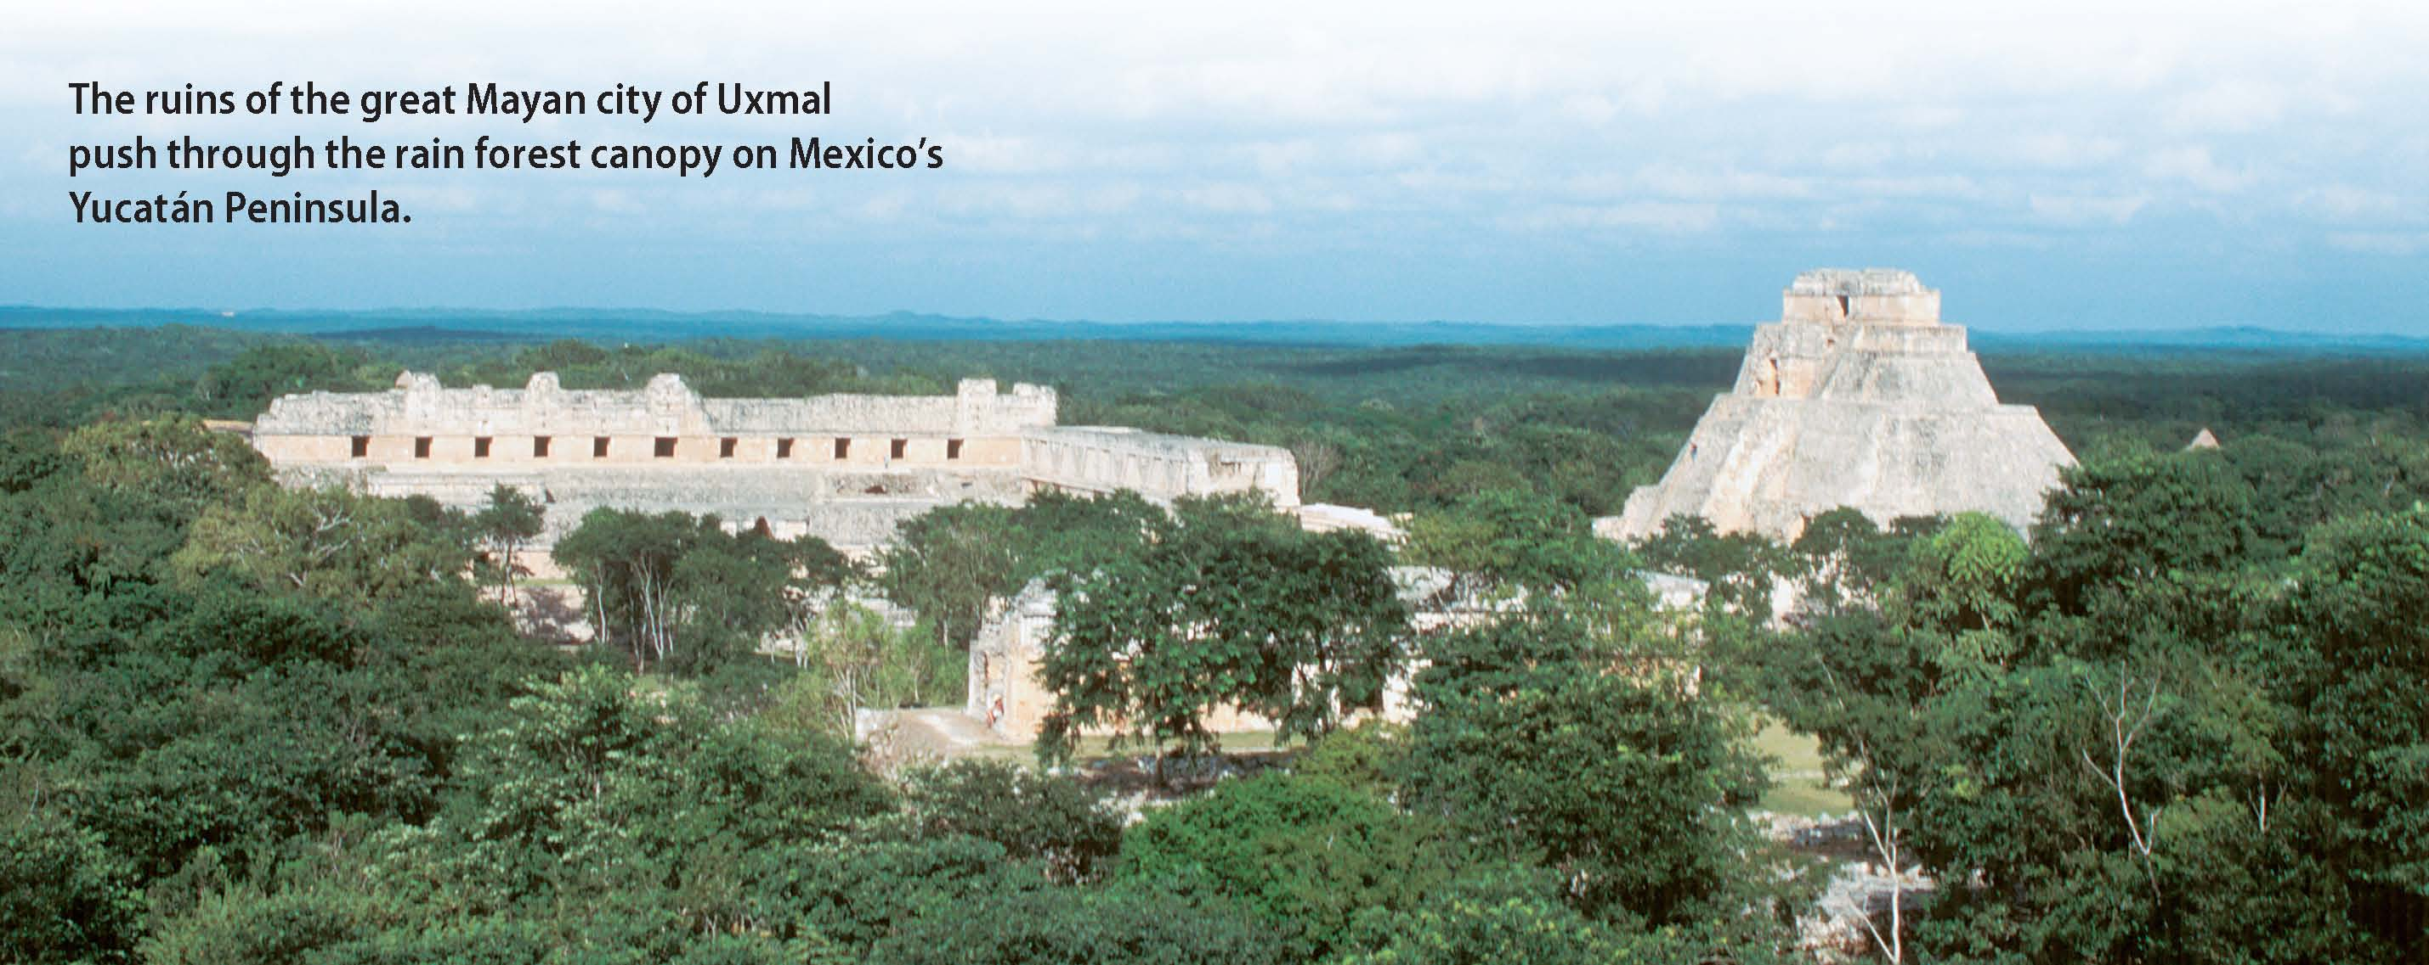
A Lost Civilization
Why do societies rise and fall?

Slide 60
Functionalist Theories
Cyclical Theory
Societies arise, develop in stages, and then decline.
Oswald Spengler: Societies pass through four stages represented as human-life stages.
Pitirim Sorokin: Societies swing between extremes of faith and science.
Principle of immanent change: Natural tendency toward change suggested by Sorokin

Slide 61
Functionalist Theories
Evolutionary Theory
Societies change only toward increasing complexity.
Additive process—each adaptation in society is the basis for future adaptations.
Social changes come from many sources and take many paths.
Equilibrium Theory
A change in one part of the social system produces changes in all of the other parts of the system.

Slide 62
Reading Check
Summarize
How do cyclical theory, evolutionary theory, and equilibrium theory explain social change?
Answer: cyclical theory—societies rise, go through various stages of development, and then fall; evolutionary theory—society moves towards increasing complexity; equilibrium theory—a change in one part of the social system produces changes in all other parts of the system

Slide 63
Conflict Theory
According to conflict theorists, change results from conflicts between groups with opposing interests. Most conflicts arise from disputes over access to power and wealth.
Marx and Class Conflict
Class conflict: All societies throughout history have been subject to conflicts between the people who have power and those who lack power.
Social change arises from the powerless seeking power.
Violent revolution would result in classless society.
Notes:
–

Slide 64
Conflict Theory
According to conflict theorists, change results from conflicts between groups with opposing interests. Most conflicts arise from disputes over access to power and wealth.
Dahrendorf and Social Conflict
Agreed with Marx that conflict is a central feature of all societies
Claims that social conflict can take many forms
Violent revolution not always necessary
Modern critics claim scope of conflict theories is too limited
Notes:
–

Slide 65
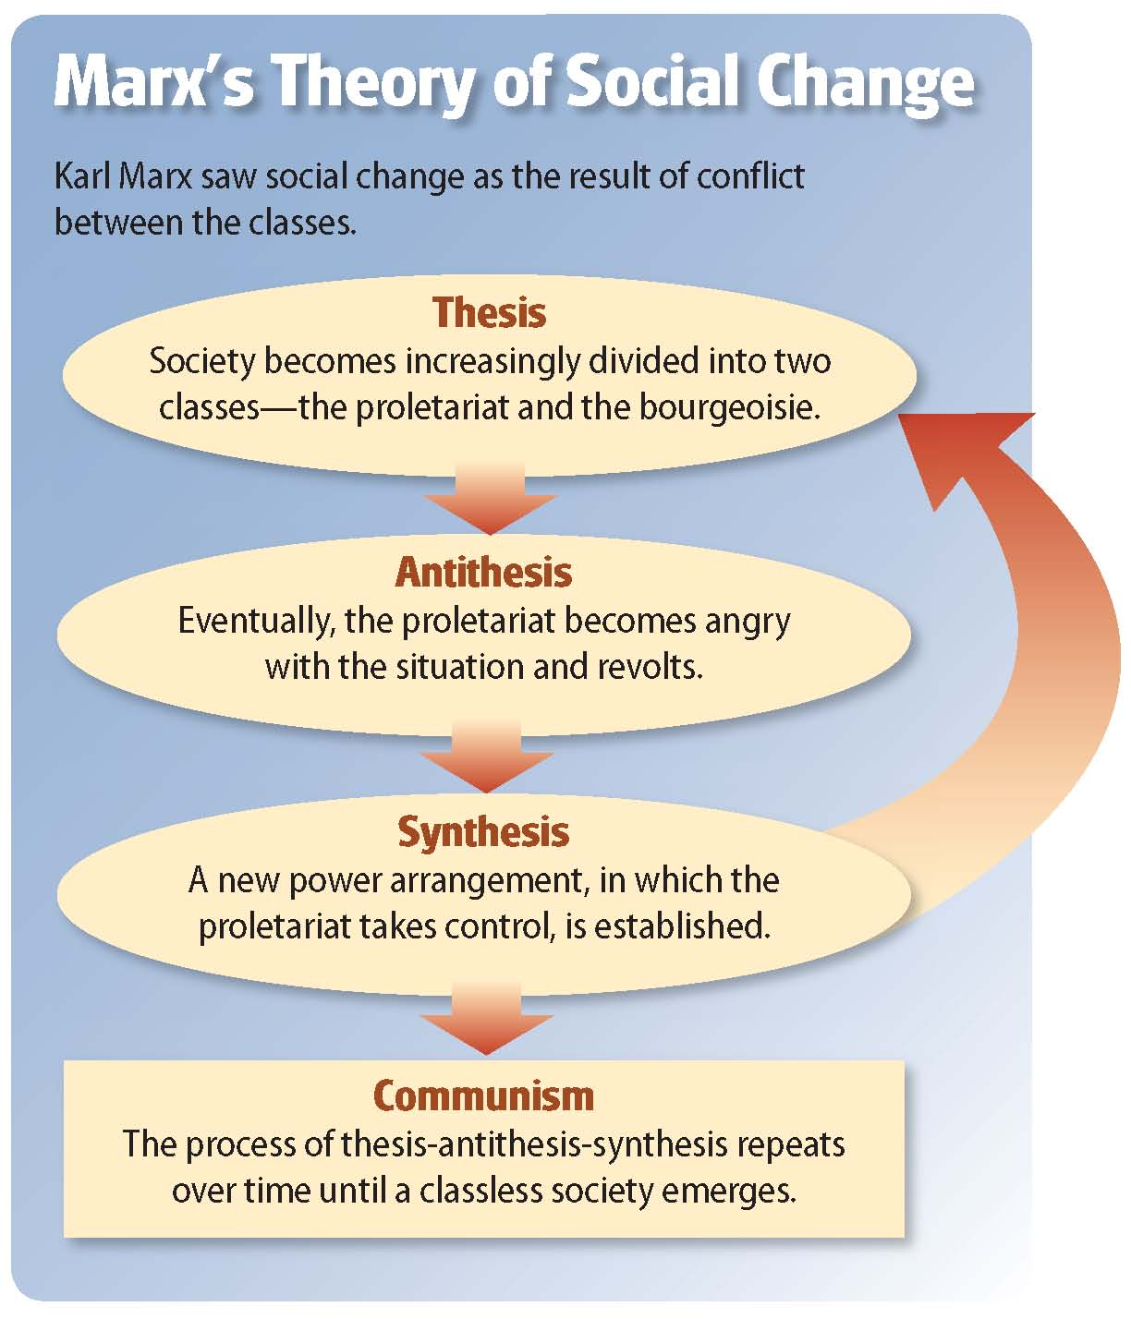
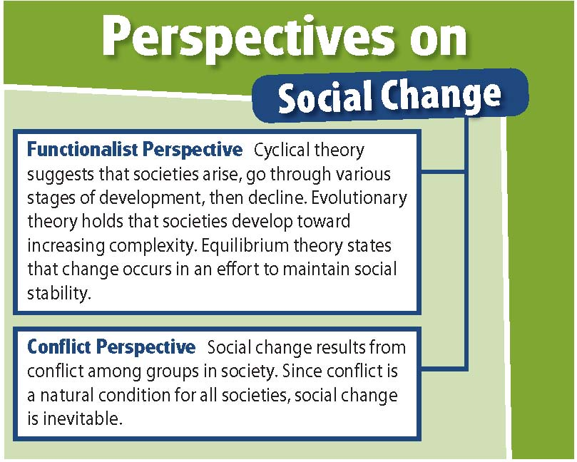

Slide 66
Reading Check
Contrast
How do Dahrendorf’s views on social change differ from Marx’s views?
Answer: Marx believed that social change occurs when the powerless attempt to gain power, while Dahrendorf believed social change could be accomplished through compromise.

Slide 67
Section 5 at a Glance
Modernization
Modernization is the process by which a society’s social institutions become more complex.
Sociologists offer two explanations for this process: modernization theory and world-system theory.

Slide 68
Modernization
Main Idea
Modernization is the process by which a society’s social institutions become more complex. Sociologists offer two explanations of this process: modernization theory and world-system theory.
Reading Focus
How do sociologists explain the process of modernization?
What impact has modernization had on social life and the natural environment?

Slide 69
What are the costs of modernization?

Slide 70
The Process of Modernization
Modernization: The process by which a society’s social institutions become increasingly complex as the society moves toward industrialization.
Of the two groups of countries—more developed and less developed—the more developed nations have modernized much more rapidly.

Slide 71
The Process of Modernization
Modernization Theory
More-developed nations modernized because they were the first to industrialize.
Other nations will modernize as they industrialize.
To speed the process, many industrialized nations established assistance programs, which had little effect. Because of this failure, some have abandoned the theory.
Population and resources differ in more- and less-developed nations.

Slide 72
World-System Theory
There are three types of nations—core, peripheral, and semiperipheral.
Core nations are the most powerful developed nations, control most of the world’s resources, and have diversified economies with strong manufacturing and service sectors.
Peripheral nations control few productive resources and depend on core nations for financial aid, technology, and manufactured goods. They also provide much raw material to core nations.
Semiperipheral nations are somewhere in between core and peripheral nations.

Slide 73
World-System Theory (cont.)
Some argue that peripheral nations gain from economic interactions. Others feel peripheral nations actually gain little from these interactions.
Peripheral nations put their entire focus on the needs of core nations, so there is little diversification.
Money becomes concentrated with the few who rule the peripheral nations.
Theory does not account for the reasons behind core nations’ growth.

Slide 74
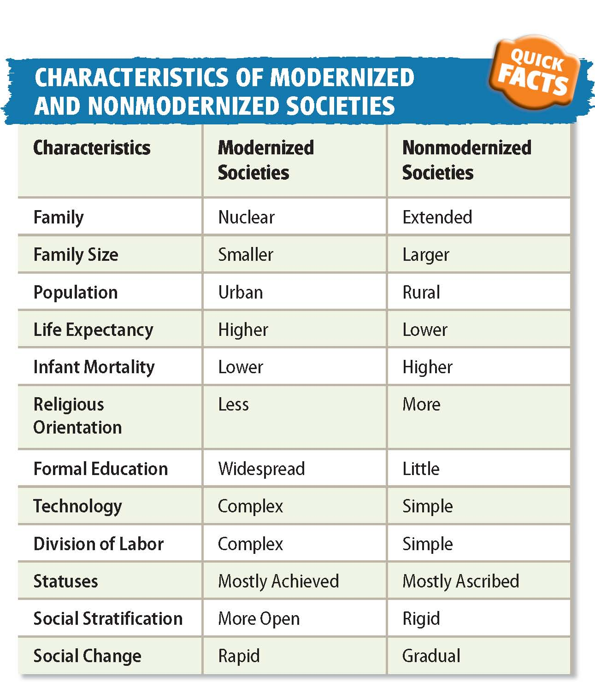

Slide 76
Reading Check
Contrast
How do modernization theory and world-system theory differ in the way they look at modernization?
Answer: Modernization theory states that more-developed nations modernized because of industrialization, while world-system theory views modernization in terms of the world economy

Slide 77
The Impact of Modernization
Positive consequences:
Increase in standard of living
Longer life expectancies, lower birthrates, higher rates of literacy, a decrease in economic and social inequality, and more personal comforts.
Improves infrastructure: the system of roads, ports, and other facilities needed by a modern economy
Brings electricity, telephones, computers, and universities

Slide 78
The Impact of Modernization
Negative consequences:
Family and religion lose some authority
Government takes a larger role in a person’s life
Social relationships are likely to be weaker
New technology brings new moral and ethical questions
Often harms environment

Slide 79
Reading Check
Summarize
What are some of the positive and negative consequences of the modernization process?
Answer: positive—increased standard of living, decreased economic and social inequality; negative—increased social problems, rise in moral and ethical questions, destruction of the natural environment

Slide 80
Simulation: Applying What You’ve Learned
Creating a Social Movement
What methods can be used to attract support for a social movement?
1. Introduction
2. Identifying a Social Movement
In this simulation, you will review collective behavior and social movements.
Think of an ideology that could turn into a social movement.
Work in a group to publicize your social movement using a Web site.
After reviewing the information in this chapter, think of a social movement to promotes. Find answers to three questions:
What is our ideology?
Which type of social movement?
Which theory best explains why a social movement will develop?
Notes:
–

Slide 81
Simulation (cont.)
3. Simulating a Public Opinion Committee
As a committee, design and construct a Web site that will help popularize your movement. Your Web site should:
use a propaganda technique identified in this chapter.
includes a memorable logo, theme, or motto.
be illustrated.
emphasize the ideology of the movement.
4. Identifying Propaganda Techniques
Within your group, look for a way you could have used each of the techniques on your Web site.
Each group should present its Web site.
As Web sites are presented, write down which type you think has been used.
Vote as a class on which technique was being used.

Slide 82
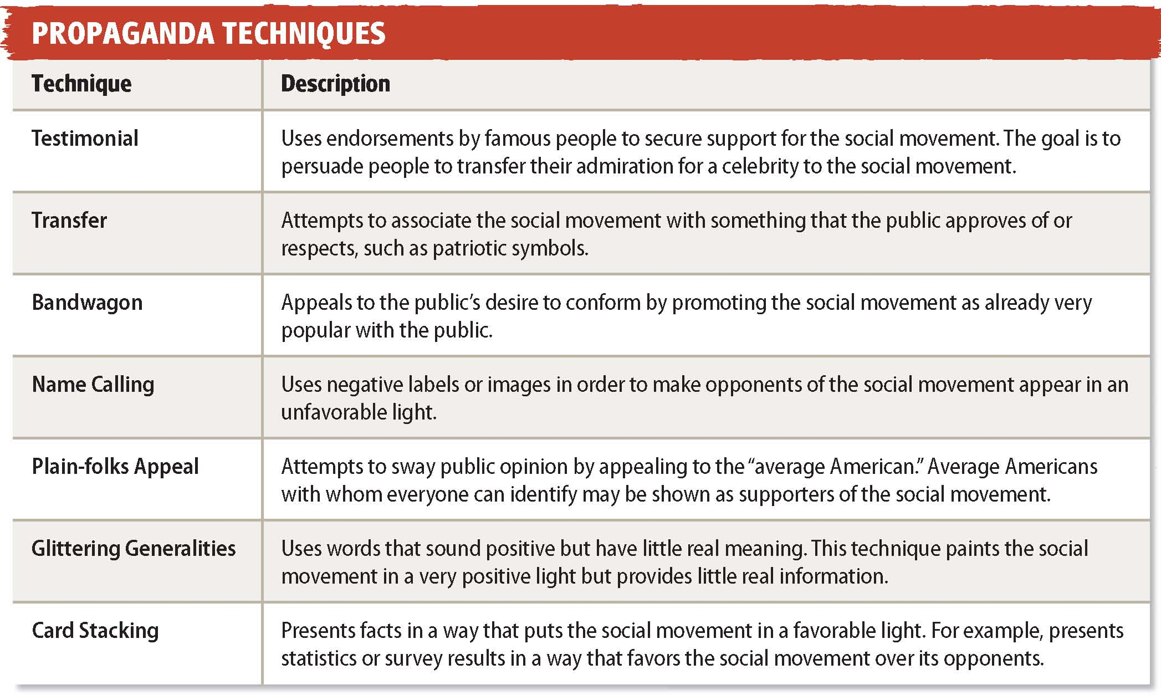

Slide 83
Simulation (cont.)
5. Discussion
What did you learn from this lab? As a group, discuss the following:
How successful was the class at determining which propaganda techniques were being used?
How successful was the class at using different propaganda techniques?
Were some techniques easier or harder to use?
What types of propaganda do some modern social movements use?

