Slide 1
8th Grade
Modern Literature Unit
Literature Circles-series novels

Slide 2



Slide 3
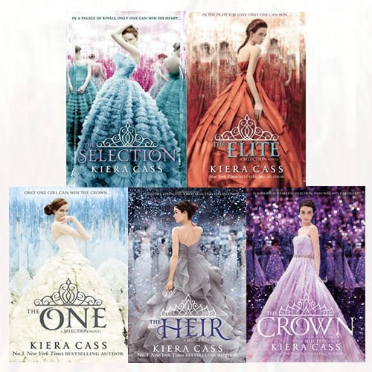

Slide 4


Slide 5



Slide 6


Slide 7
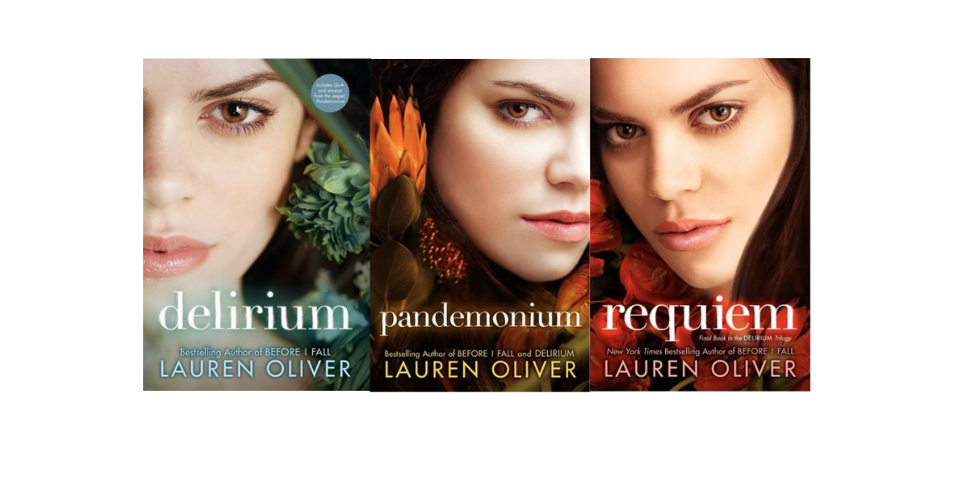

Slide 8


Slide 9
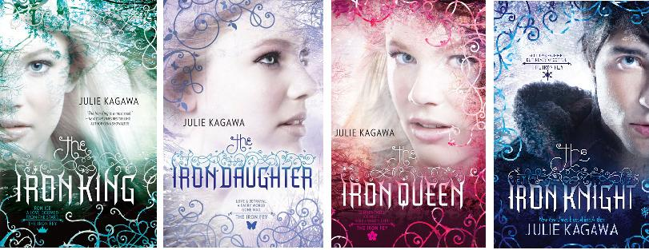

Slide 10


Slide 11


Slide 12




Slide 13


Slide 14
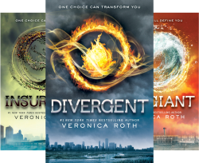

Slide 15




Slide 16


